Slide 1
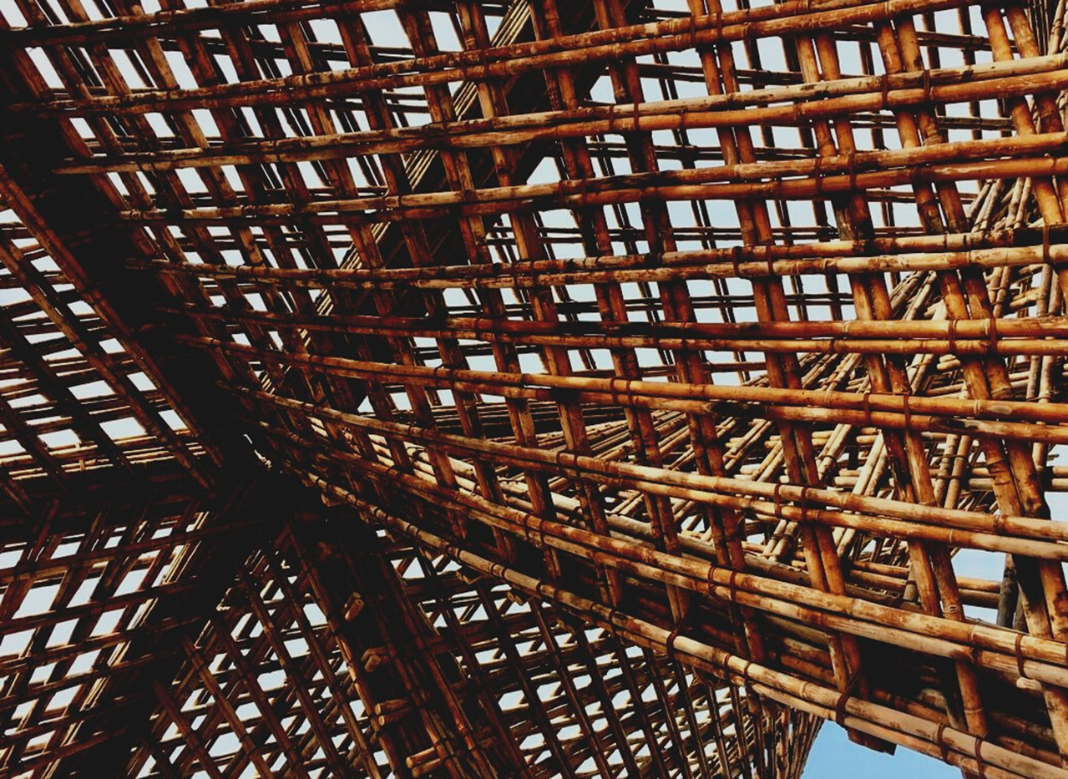
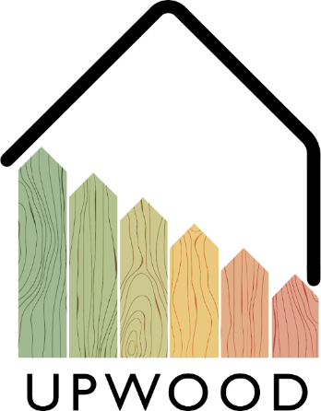
LEARNING UNIT 4: Functionality and efficiency of wooden buildings / Learning unit 4 (LU4)
Lesson 2:
Climate influence on wooden buildings.
Presentation

Slide 2
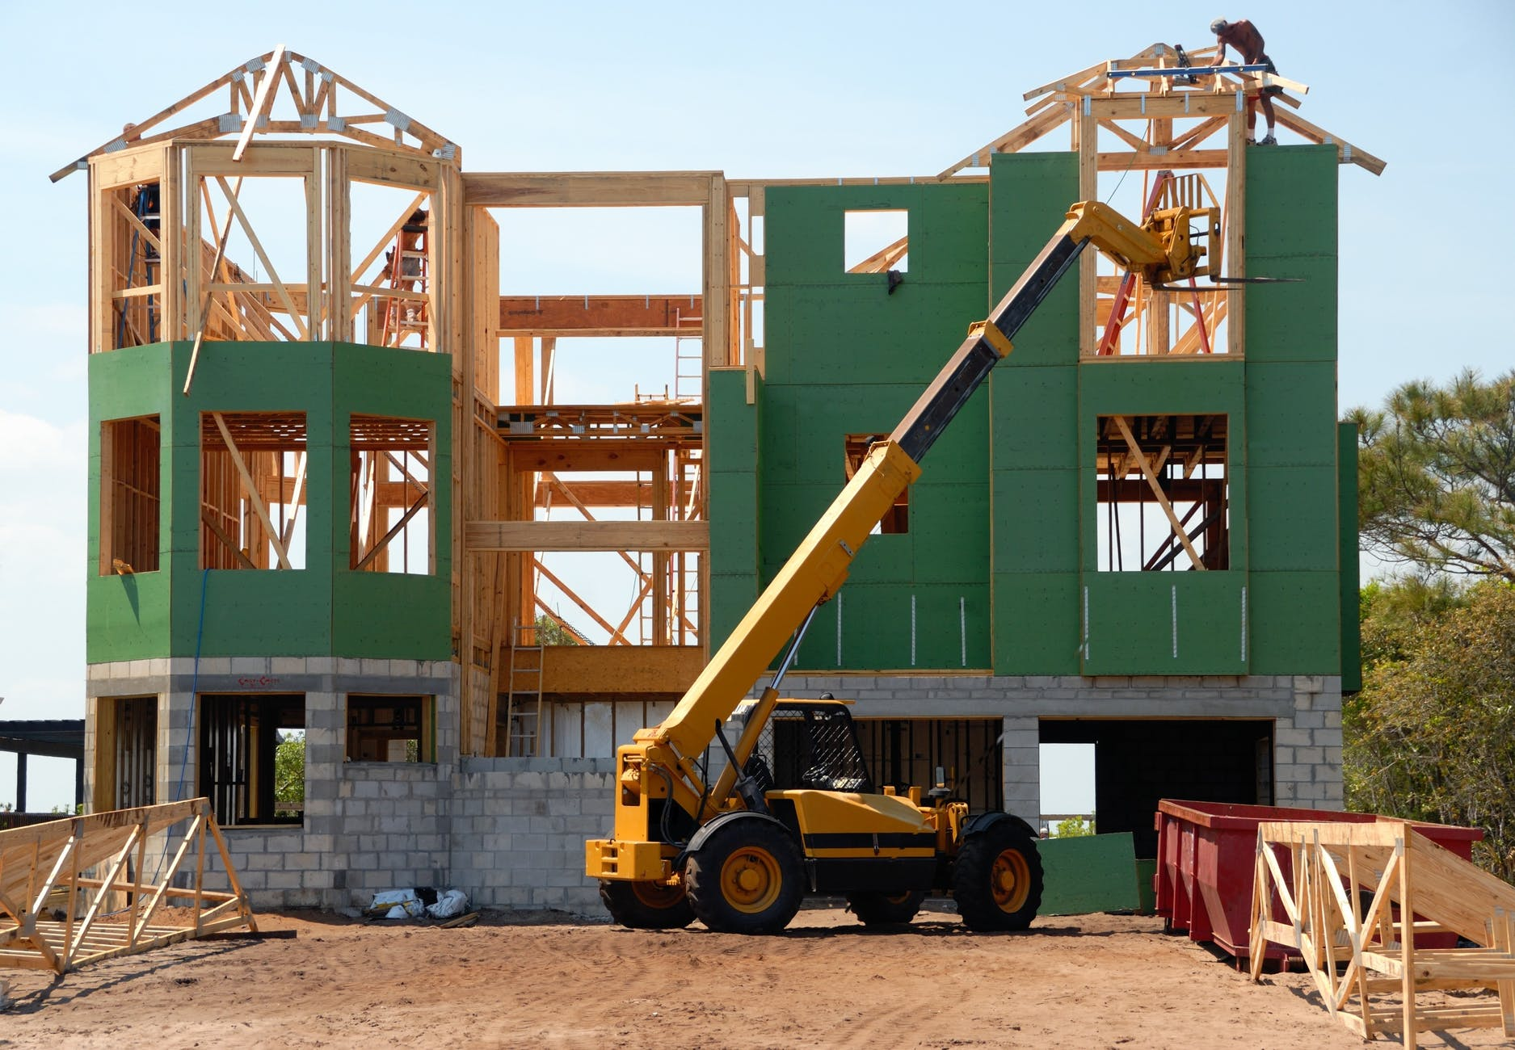
Presentation Overview
TOPICS DISCUSSED
- Climate influence on wooden buildings
- Influence of wood use in the environment
LESSON 2: Climate influence on wooden buildings

Slide 3
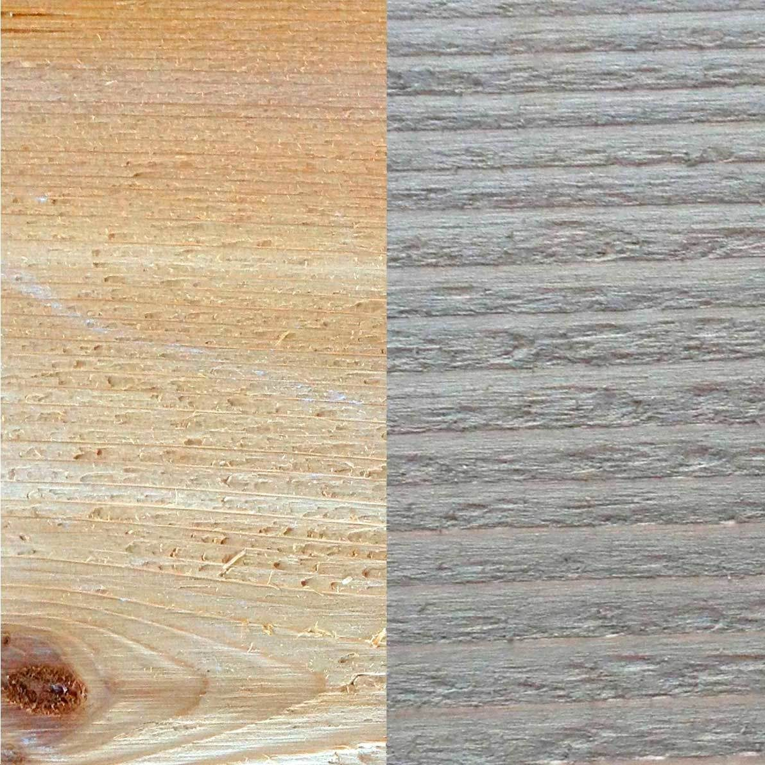
CLIMATE INFLUENCE ON WOODEN BUILDINGS
Despite the great properties of wood as a constructive material, it is really important to have in consideration the ageing of every components, regarding the adverse climatological and natural conditions to which it is exposed.
As we will be able to see, some of these adversities will affect the material in a surface layer, but some of them can become in a serious pathology for the timber elements.
3
LESSON 2: Climate influence on wooden buildings

Slide 4
Degradation agents
Fungus.
As mentioned in the previous topic, a high rate of humidity, together with some features, such as temperature and amount of Oxigen, can forward the appearance of fungus in wood elements.
Solar radiation.
The sun light that gets to earth surface is composed of a wide radiations spectrum that can be divided in three groups: Ultraviolet rays, visible rays, and Infra-red rays.
Insects.
The insects that can affect wood elements can be divided in four different groups: Anobides, Lictides, Cerambycids and Termites.
The main trick in order to control the decomposition of wood is to have an adequate control of humidity. Once fungus start to decompose the wood, if the humidity values are above 22% they can spread on, so to protect wood against its spread, it is recommended to keep the humidity content below 19%.
Water.
Water is a component that can easily travel through the varnish layer, and interfere in the relative humidity of the wood. This increase of relative humidity can foster the spread of fungus that damage the wood integrity.
LESSON 2: Climate influence on wooden buildings

Slide 5
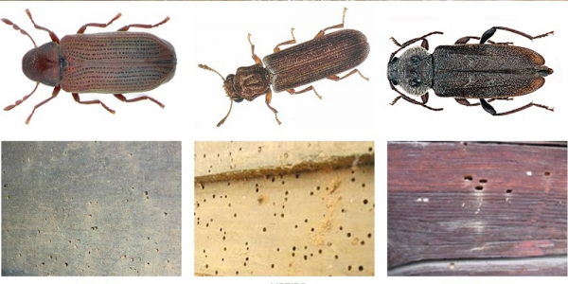
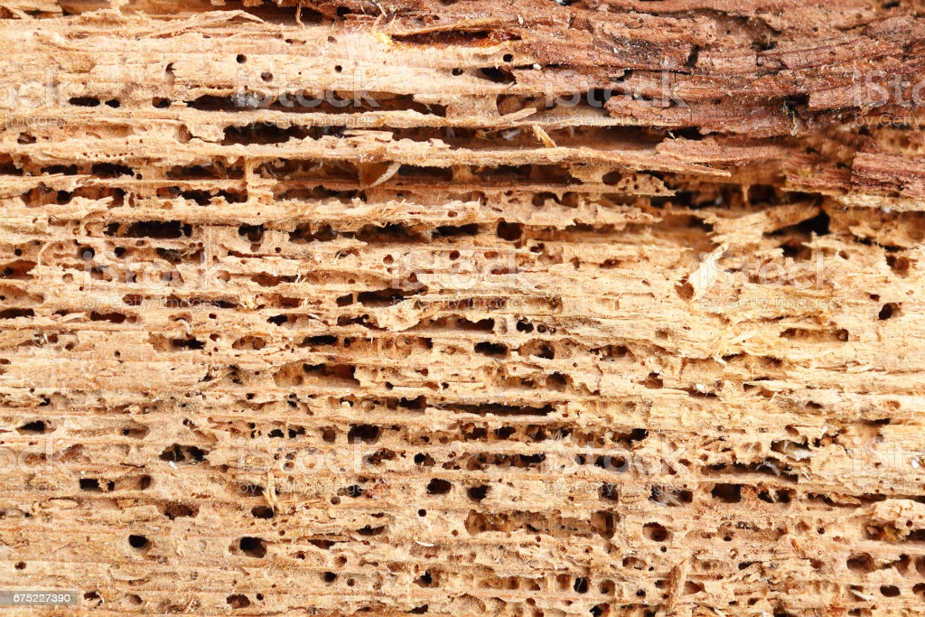
Insect pathologies
Anobides Lictides Cerambycides
5
LESSON 2: Climate influence on wooden buildings

Slide 6
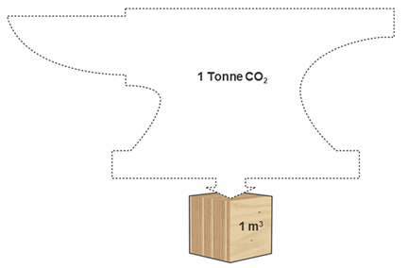
INFLUENCE OF WOOD IN THE ENVIRONMENT
The use of wood in the construction sector is not only less detrimental for the environment than other materials, but can be even positive, since its use assures the reforestation of vast surfaces with new trees. The main reason why this is positive is because new trees absorb more CO2 from the atmosphere than older trees, and since the use of wood require some deforestation and a compensating reforestation, this means that older trees with less absorption will be replaced by newer trees with better absorption values. Also, wood used in construction can still absorb some CO2, enhancing the renovation of the air surrounding the buildings, and contributing to the global CO2 absorption.
6
LESSON 2: Climate influence on wooden buildings

Slide 7
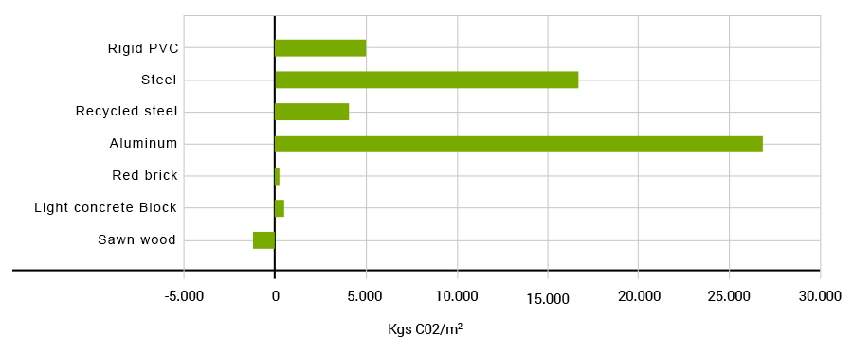
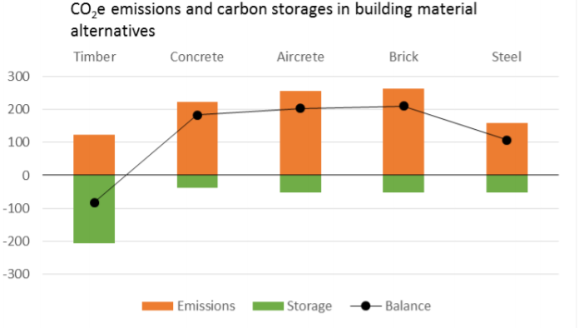
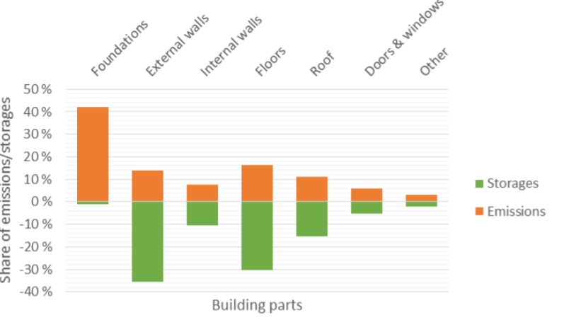
Environmental footprint
LESSON 2: Climate influence on wooden buildings

Slide 8
Benefits of timber use for the environment
FOREST RENOVATION
CO2 ABSORPTION
Since the timber use requires consumption of several trees, the reforestation would renovate the forest, providing a better quality air in the atmosphere
Wood can keep absorbing CO2 even after the tree is cut, so each timber dwelling helps to the environment to have a better atmosphere.
ENERGY REQUIREMENTS
RECYCLABLE AND REUSABLE
Timber production is a clean industry, since it does not require high-demanding industrial processes.
Timber elements in construction can be used more than once. Also, once the timber element is no longer useful, it can be recycled for other purposes.
LESSON 2: Climate influence on wooden buildings

