Slide 1
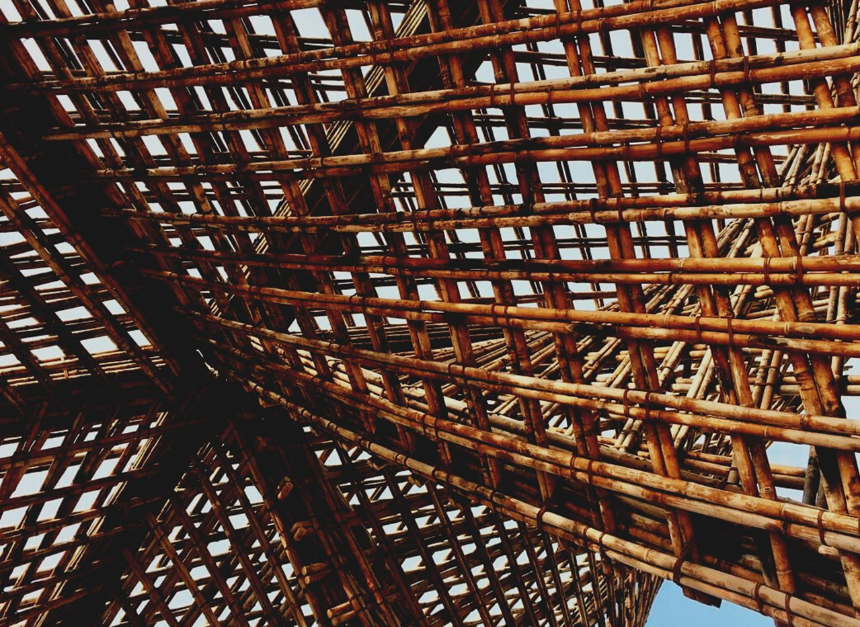
LEARNING UNIT 4: Functionality and efficiency of wooden buildings / Learning unit 4 (LU4)
Lesson 4:
Insight to heating, ventilation, air conditioning, lighting, information and communications technologies systems and its applications in modern buildings.
Presentation

Slide 2
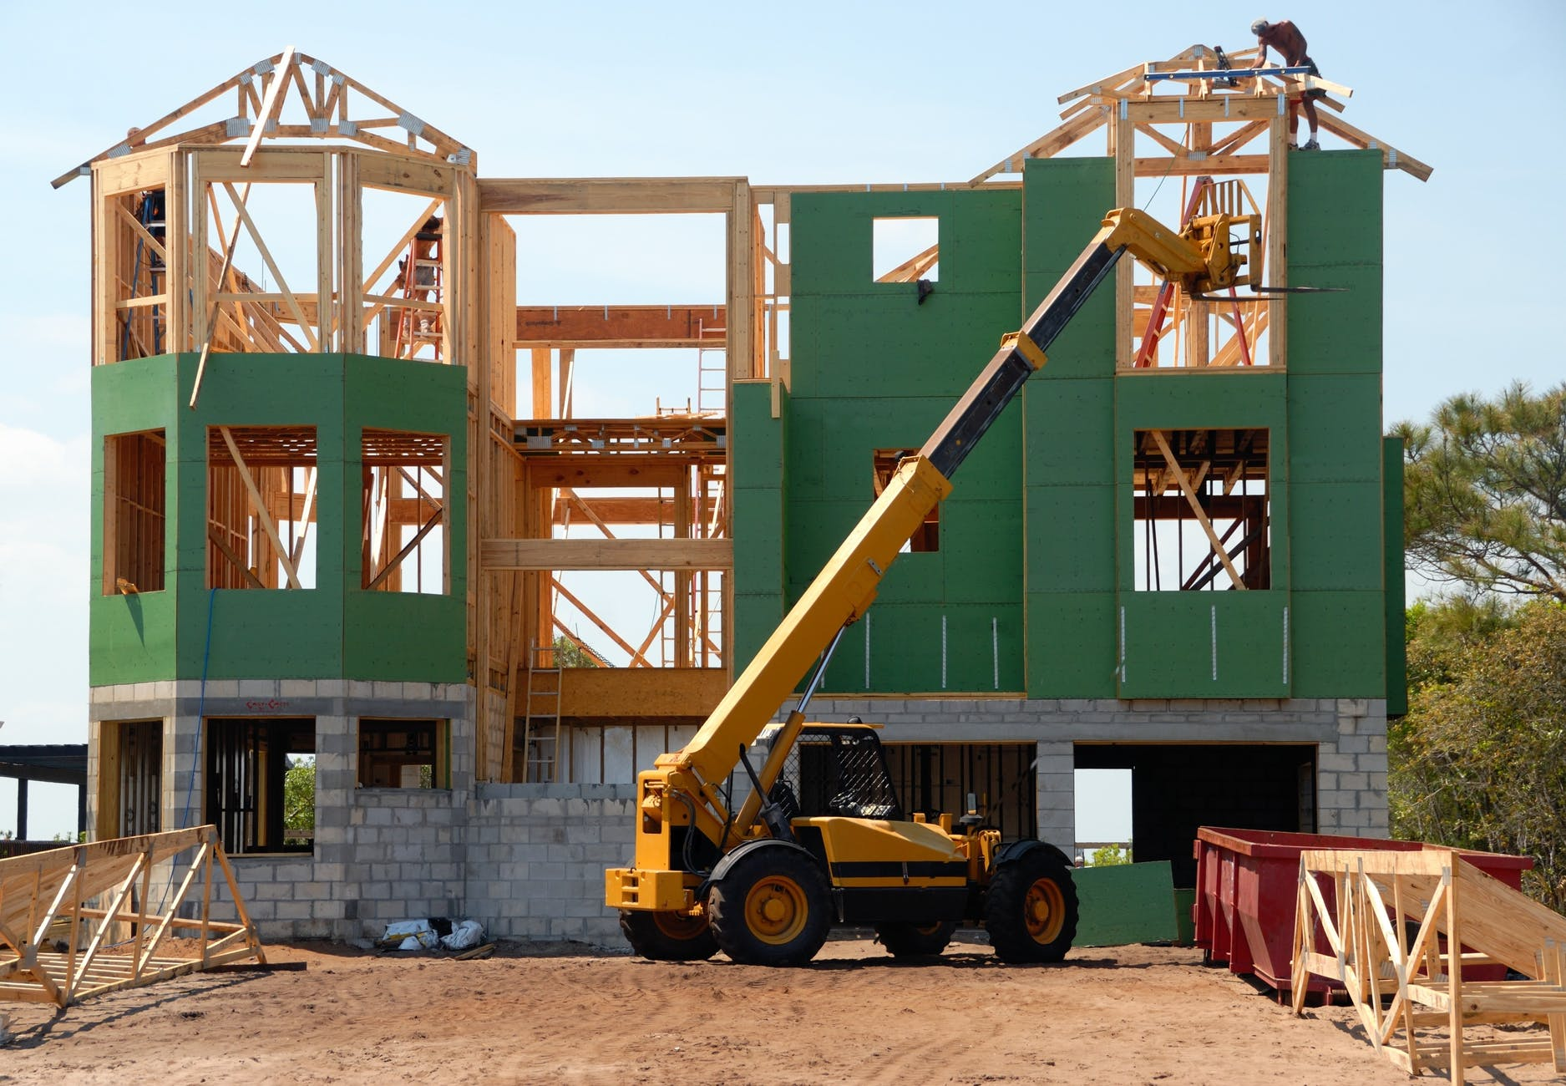
Presentation Overview
TOPICS DISCUSSED
- Electrical notions
Notions of ventilation
Notions of air conditioning
Notions of telecommunications.
LESSON 4:Insight to heating, ventilation, air conditioning, lighting, information and communications technologies systems and its applications in modern buildings.

Slide 3
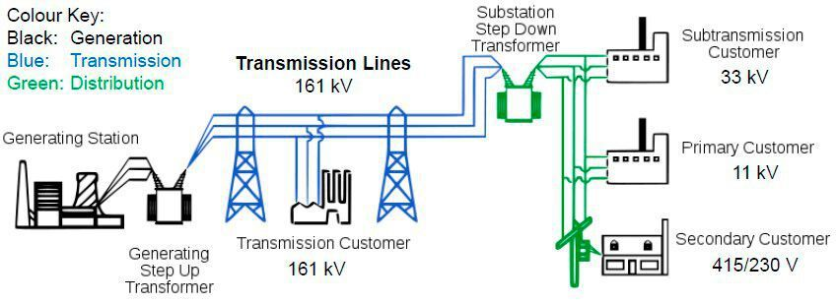
ELECTRICAL NOTIONS
The origin of electrical power is in generating stations, where we can find the alternators. The tension energy is elevated in step-up transformers to been transported through the transmission lines. When the energy is near the consumption places, the energy tension is reduced reaching the primary distribution network. When the point of use is reached the tension must be adjusted to the domestic one in the step-down transformer.
3
LESSON 4:Insight to heating, ventilation, air conditioning, lighting, information and communications technologies systems and its applications in modern buildings.

Slide 4
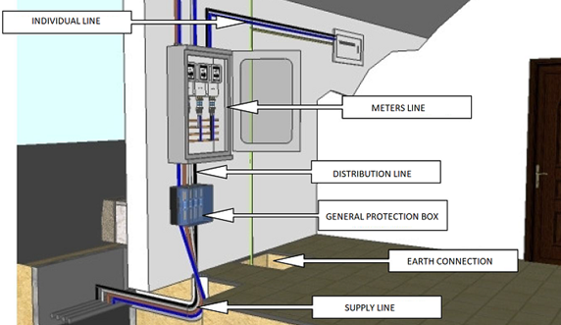
Parts of electric installation
Supply line
Link installations:
General protection box.
General power supply.
-- General shunting breaker--
Meters
Individual line
Box for power control circuit breaker
General devices of control and protection
Interior installation
Interior installation.
LESSON 4:Insight to heating, ventilation, air conditioning, lighting, information and communications technologies systems and its applications in modern buildings.

Slide 5
VENTILATION AND AIR CONDITIONING
Ventilation
Ventilation is a necessary mechanism for the renovation of indoor air, but also has positive effects on the thermal conditions of the premises. Housing must have a general ventilation system that can be hybrid or mechanical.
Air conditioning
Air conditioning must be able to maintain the levels of comfort required by the user and its conditions are going to be different in summer or winter. To produce the constant flow of cool fluid there are two possible methods: compression and absorption. The most used are the compression mechanisms based in the inverted Carnot cycle.
5
LESSON 4:Insight to heating, ventilation, air conditioning, lighting, information and communications technologies systems and its applications in modern buildings.

Slide 6
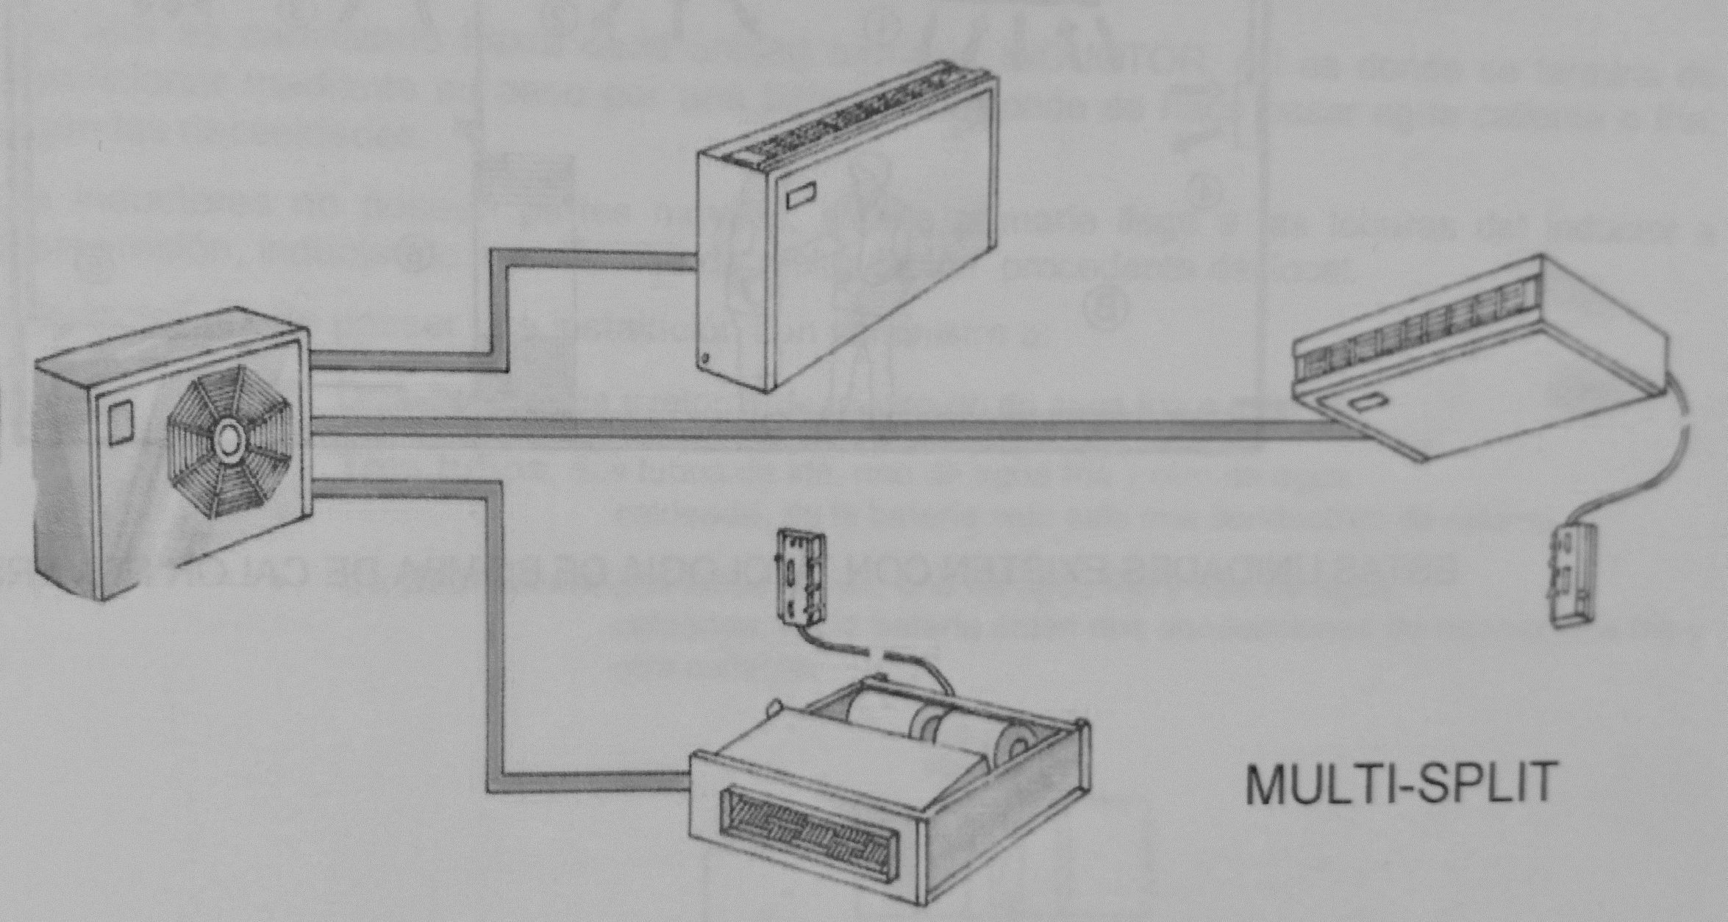
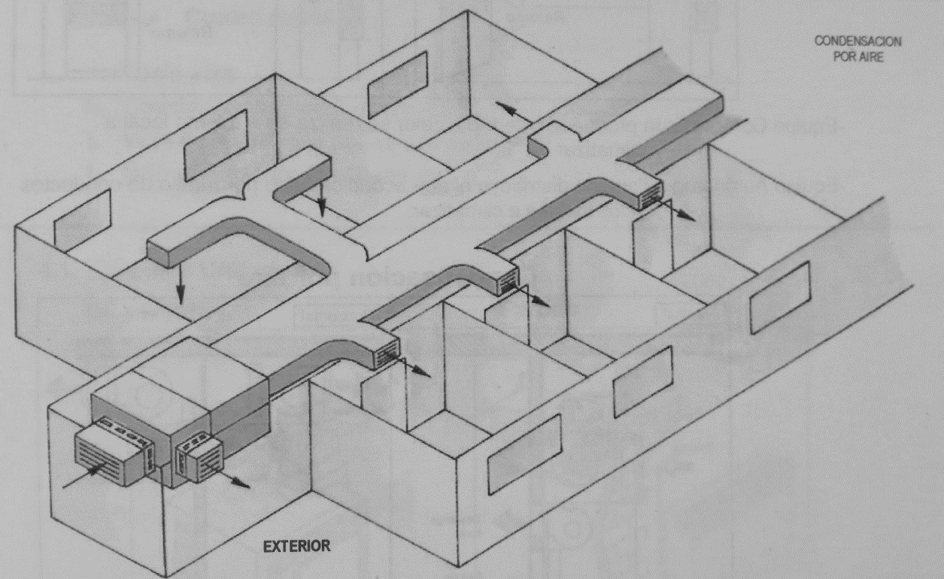
Types of installation
1. Purpose
- Industrial processes
- Comfort installation
2. Season
- Only winter
- Only summer
- All year
3. Refrigeration fluid
- Air
- Water
- Refrigerants
4. Installation
4.1 Unit
-For windows and portables
- Compacts and autonomous units’ condensate by air
- Compacts and autonomous units’ condensate by water
4.2 Parted system
- Split type (discharge by conducts or direct)
- multi-split
4.3 Centralized systems
- Mixed (induction or fan coil)
- All air (steady flow, variable volume, two conducts)
LESSON 4:Insight to heating, ventilation, air conditioning, lighting, information and communications technologies systems and its applications in modern buildings.

Slide 7
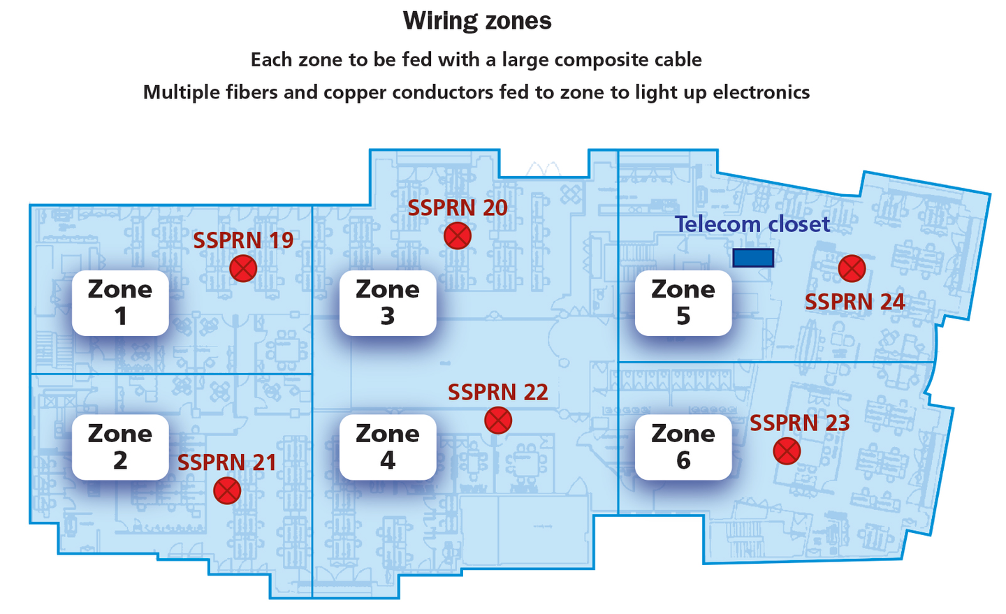
NOTIONS OF
TELE-COMUNICATIONS
This type of installations capture, adapt and distribute to the houses and establishments all sort of telecommunication devices. The entire equipment must be sufficient for all the users of the building, containing all services such television, telephone, and telecommunication by line. The design of the building should take in consideration this kind of amenities and help the adaptation to future installations. The beginning of the construction works are not allowed without the proper validation of a telecommunication installation project. During the early stages of construction works, small changes in the project are allowed, but in case of important changes a new project should be presented to the authorities and finally approved.
7
LESSON 4:Insight to heating, ventilation, air conditioning, lighting, information and communications technologies systems and its applications in modern buildings.

Slide 8
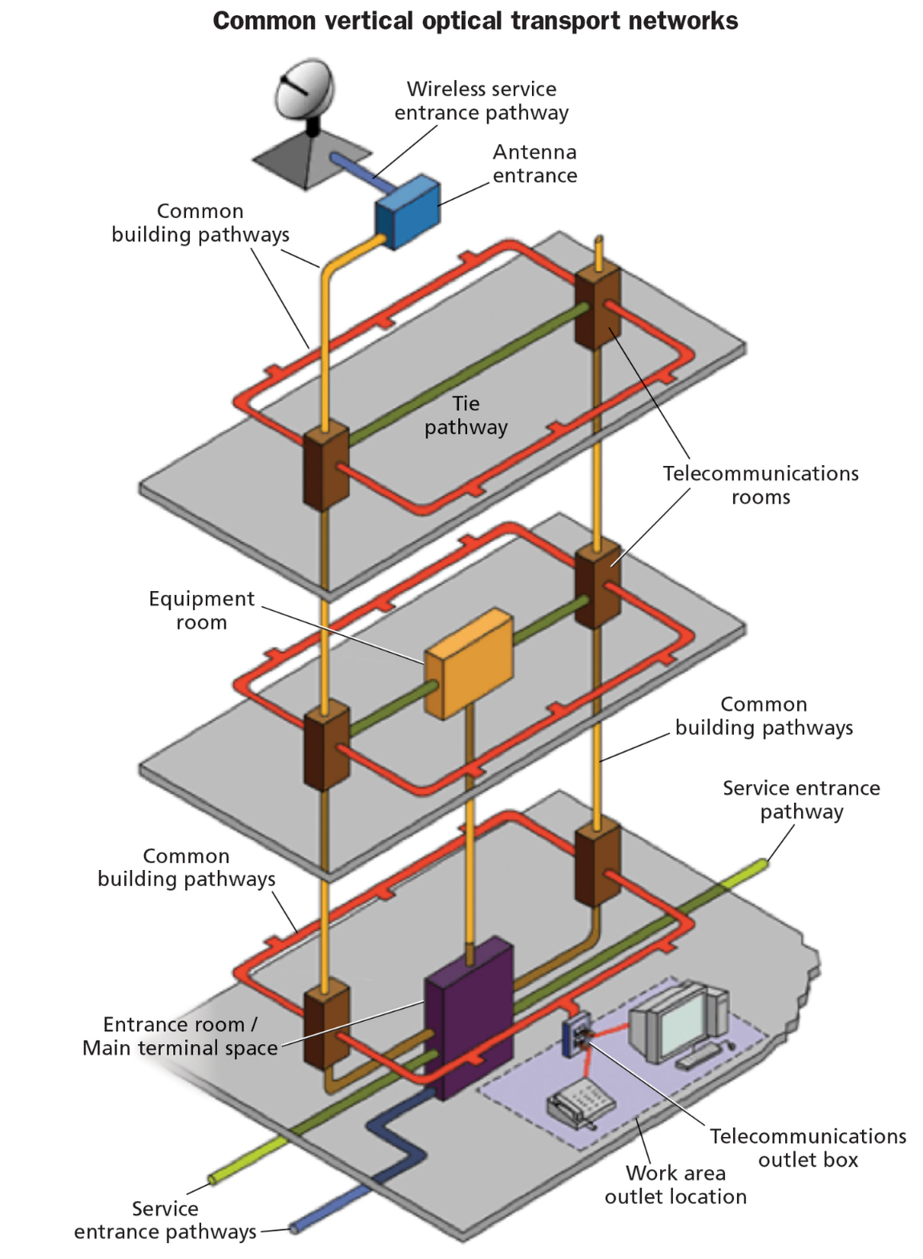
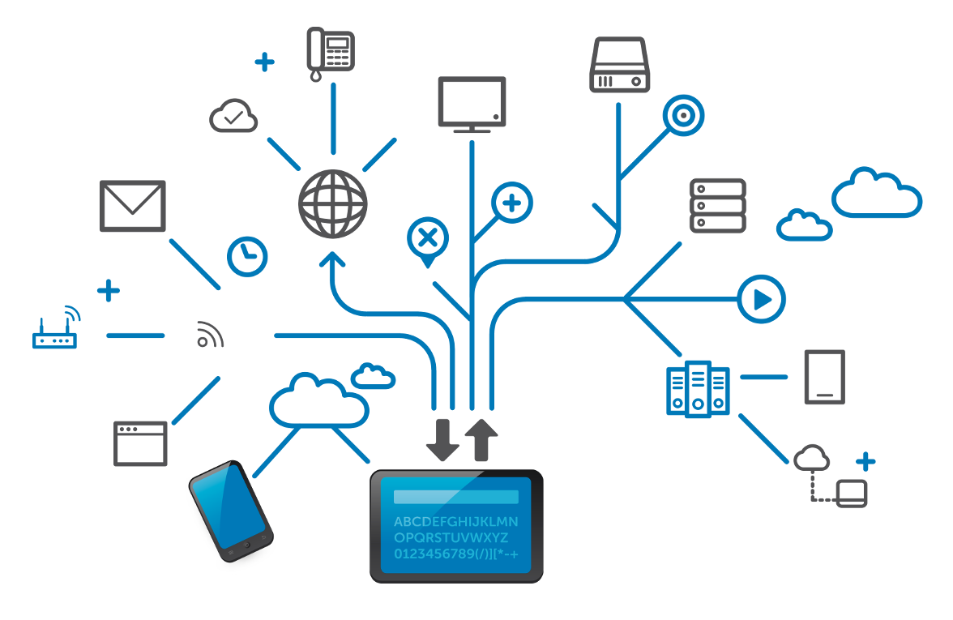
Installations
The installations chose in the ultimate projects are arranged in a vertical optical transport network that extends from the basement to the roof and appears in every telecom closet.
8
LESSON 4:Insight to heating, ventilation, air conditioning, lighting, information and communications technologies systems and its applications in modern buildings.

