Slide 1
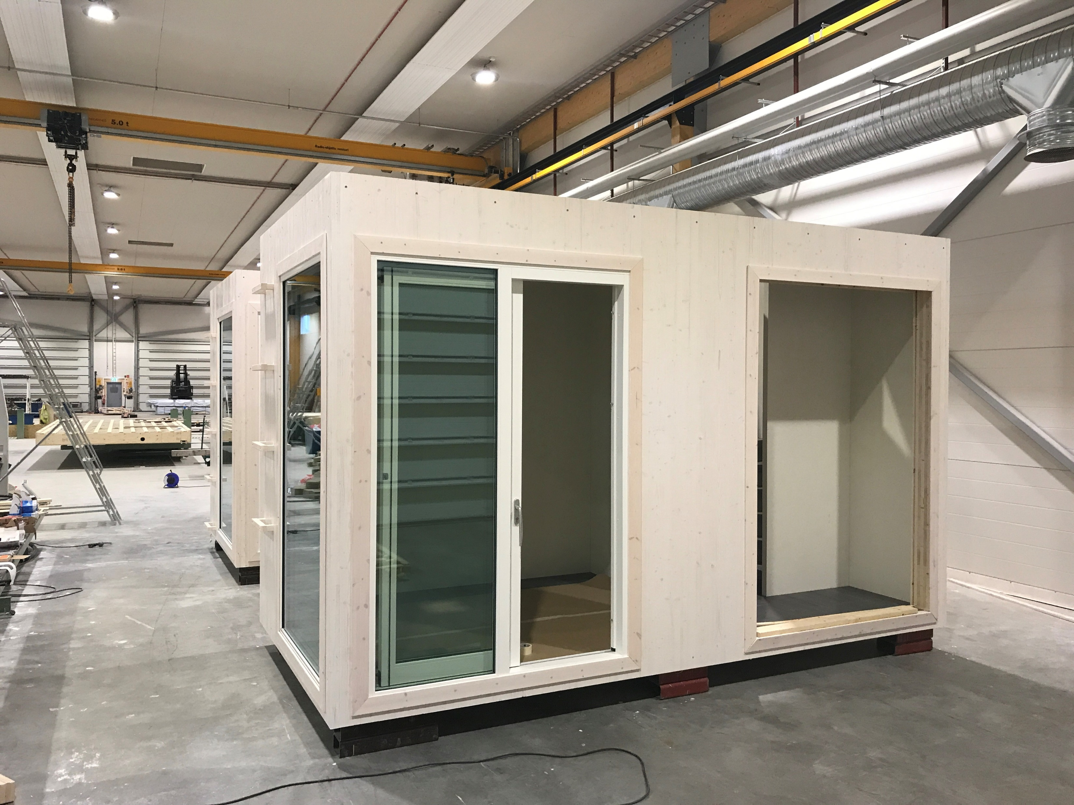
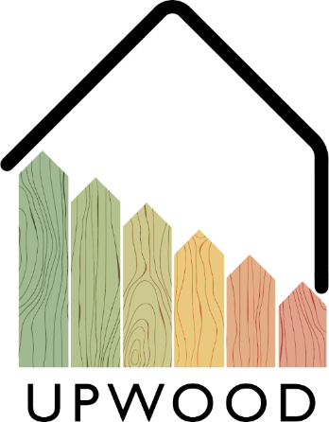
02-4/ LU3: TIMBER CONSTRUCTION, RENOVATION AND DECONSTRUCTION
THE USE OF CONSTRUCTION PRODUCTS

Slide 2
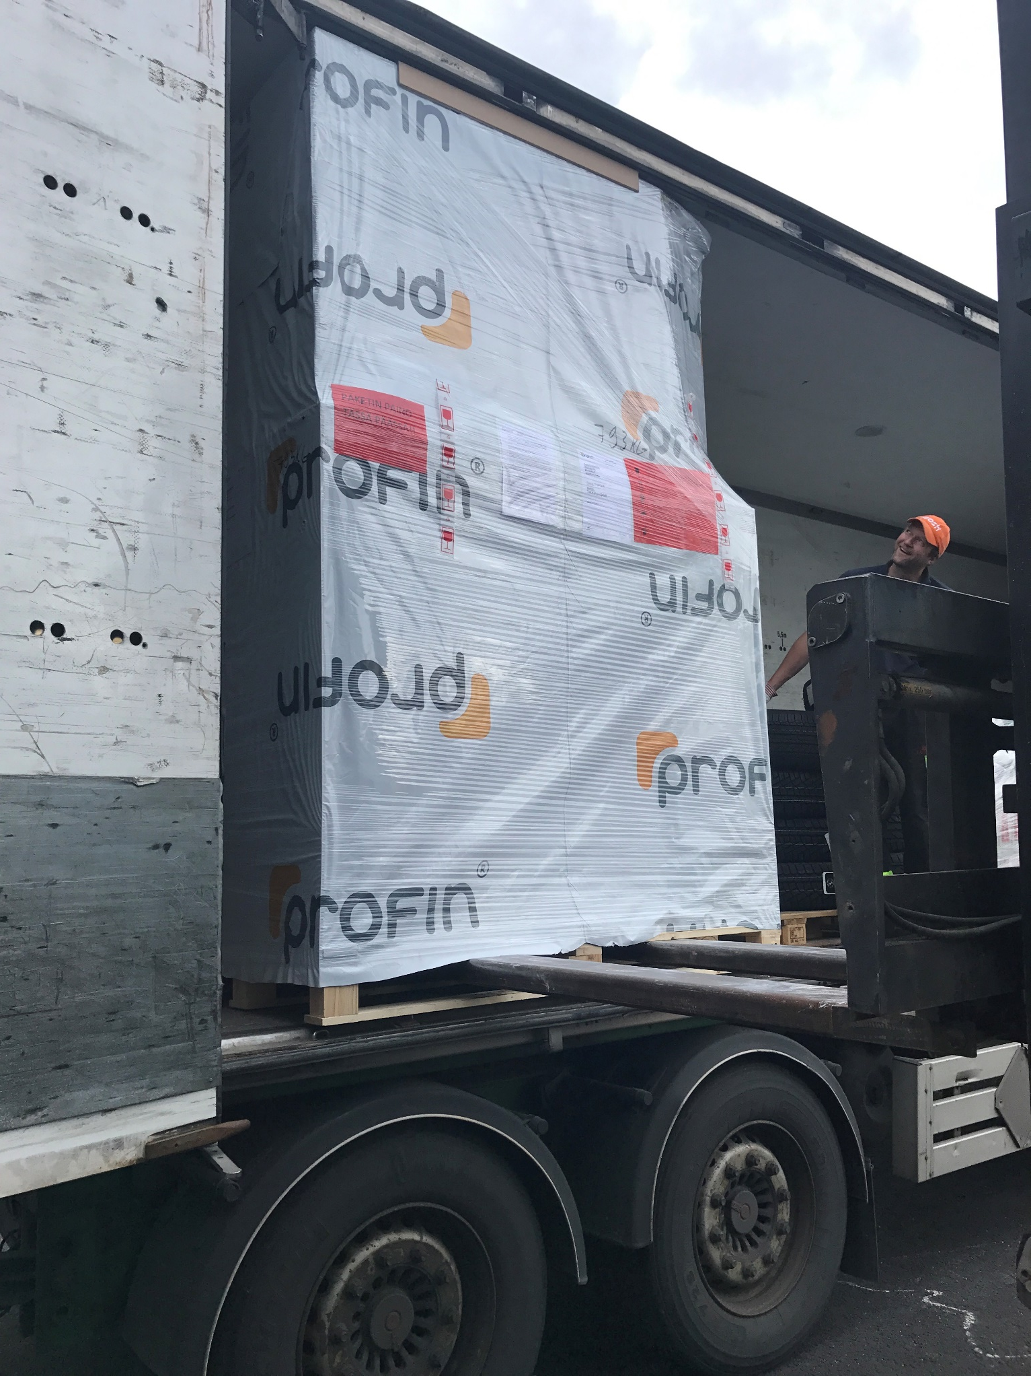
PRESENTATION OVERVIEW
Topics covered
Product approval
Eco-labels
Selecting the product
Doors
Windows
Quality of installation
Benefits
Module element
Frequently asked questions

Slide 3
A construction product is a product that is firmly integrated into buildings, such as a concrete element, window, steel structure, or lumber.
The conformity of construction products is indicated by the CE marking if the product falls within the scope of a harmonized product standard or if the manufacturer has applied for the European Technical Assessment.
Construction products must be safe and in accordance with the principles of sustainable development and must not be harmful to health.
Product approval
3

Slide 4
You should use eco-labels to identify and choose an environmentally friendly product.
The most common eco-labels in the Nordic countries are the Swan Label and the EU Ecolabel.
The above brands differ from many other brands by setting strict and absolute requirements for manufacturing, as well as considering the entire life cycle of the product and its environmental impact.
Eco-labels

Slide 5
Selecting the product
Things to consider when choosing construction products
Dimensioning
U-value
Fire safety
Sound insulation
UV and weather protection
Fixation
Sealing
Thermal insulation
Seaming
Possible additional installations
Safety in use
Service life
Maintenance during operation
5

Slide 6
The doors are made of plywood as well as press plates of different grades, which react only slightly to fluctuations in air humidity and temperature.
Doors are required for fire resistance, heat release (U-value) and sound insulation (dB value).
Balcony window doors have a more common aluminum coating on the outside, this product is also called a landscape door.
The door includes a door leaf and frame and any surrounding parts of similar frame structure, as well as hinges, locks and other fittings and seals.
The inner door is a door (intermediate door or mezzanine door) to be installed inside the building.
An exterior door is a door on the facade of a building that leads from the exterior to the inside of the building. A window door is an exterior door with a glass opening.
Construction product
DOORS
6

Slide 7
When installing a window, special care is required in tapping the gap between the window frame and the wall and in making the connection between the frame and the air barrier.
Conventional new windows have 3-4 glasses, the best windows usually have 4 glasses, as well as a selective film, as well as heat insulating between the glasses.
Standardized window types:
MS - 2-glass window that opens
MSU - In-out 2-glass window
MSK - Opening 3-glass window.
MSE - Retractable 2-frame 3-glass window
MS2E - Retractable 2-frame 4-glass window.
MEK - Fixed window glazed with a fixed solid glass element.
SE - Opening single-frame window glazed with 2- or 3-pane solid glass.
DK - Swivel-tilted, e.g., side-hinged tilt-and-turn window, can be opened both vertically or horizontally.
Construction product
WINDOWS
7

Slide 8
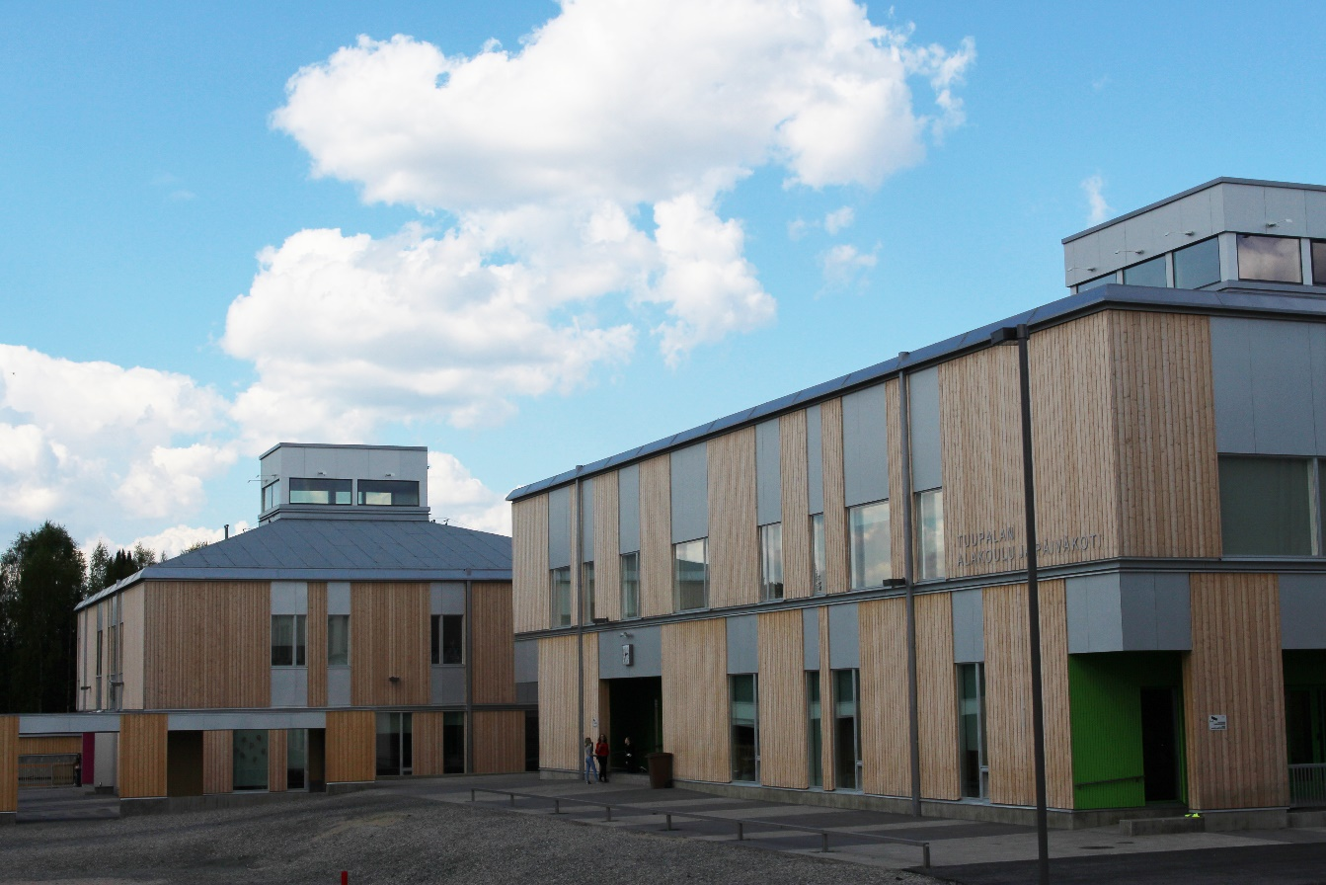
Quality of installation
Windows
The cracks in the frames must be filled in such a way that the adjacent surfaces are not damaged, soiled or discolored, and the cross-section must be ensured when the window is closed, and the opening must also be perfect.
The windows must be intact on the surface and there must be no stains, cracks or other defects on the exposed surfaces. The windowpanes must also be intact and clean and free of scratches or stains.
Doors
The installation distance of exterior door frames should be tipped so that adjacent surfaces are not damaged, soiled or discolored. There is no need to check the installation interval of interior door frames unless sound insulation requirements are set.
Door mirrors must be intact on the surface and must not have any color variations which would impair the appearance, but wood-specific color variations are permitted.
8

Slide 9
Benefits
PRODUCTIVITY
EFFICIENCY
The integration of finished construction product components into a building naturally speeds up construction and maintains quality.
Series-manufactured construction products can be mechanized, which means that production efficiency is maximized.
ENVIRONMENT
COSTS
Serial products reduce material waste and shorten both manufacturing and installation times.
The manufacturing cost of a construction product is reduced when the product can be manufactured as machine work.

Slide 10
Module element
The module elements are ready-to-move-in apartments, the technology of which is connected from the stairwells to the system of the house, so the amount of work to be done on the site is reduced. At its best, the four-story apartment building will be ready to move in within six months of starting construction.
The customer can determine the equipment level of the module element and it can either be decorated at the factory as a ready-to-move-in apartment or delivered as an unfurnished frame.
10

