Slide 1
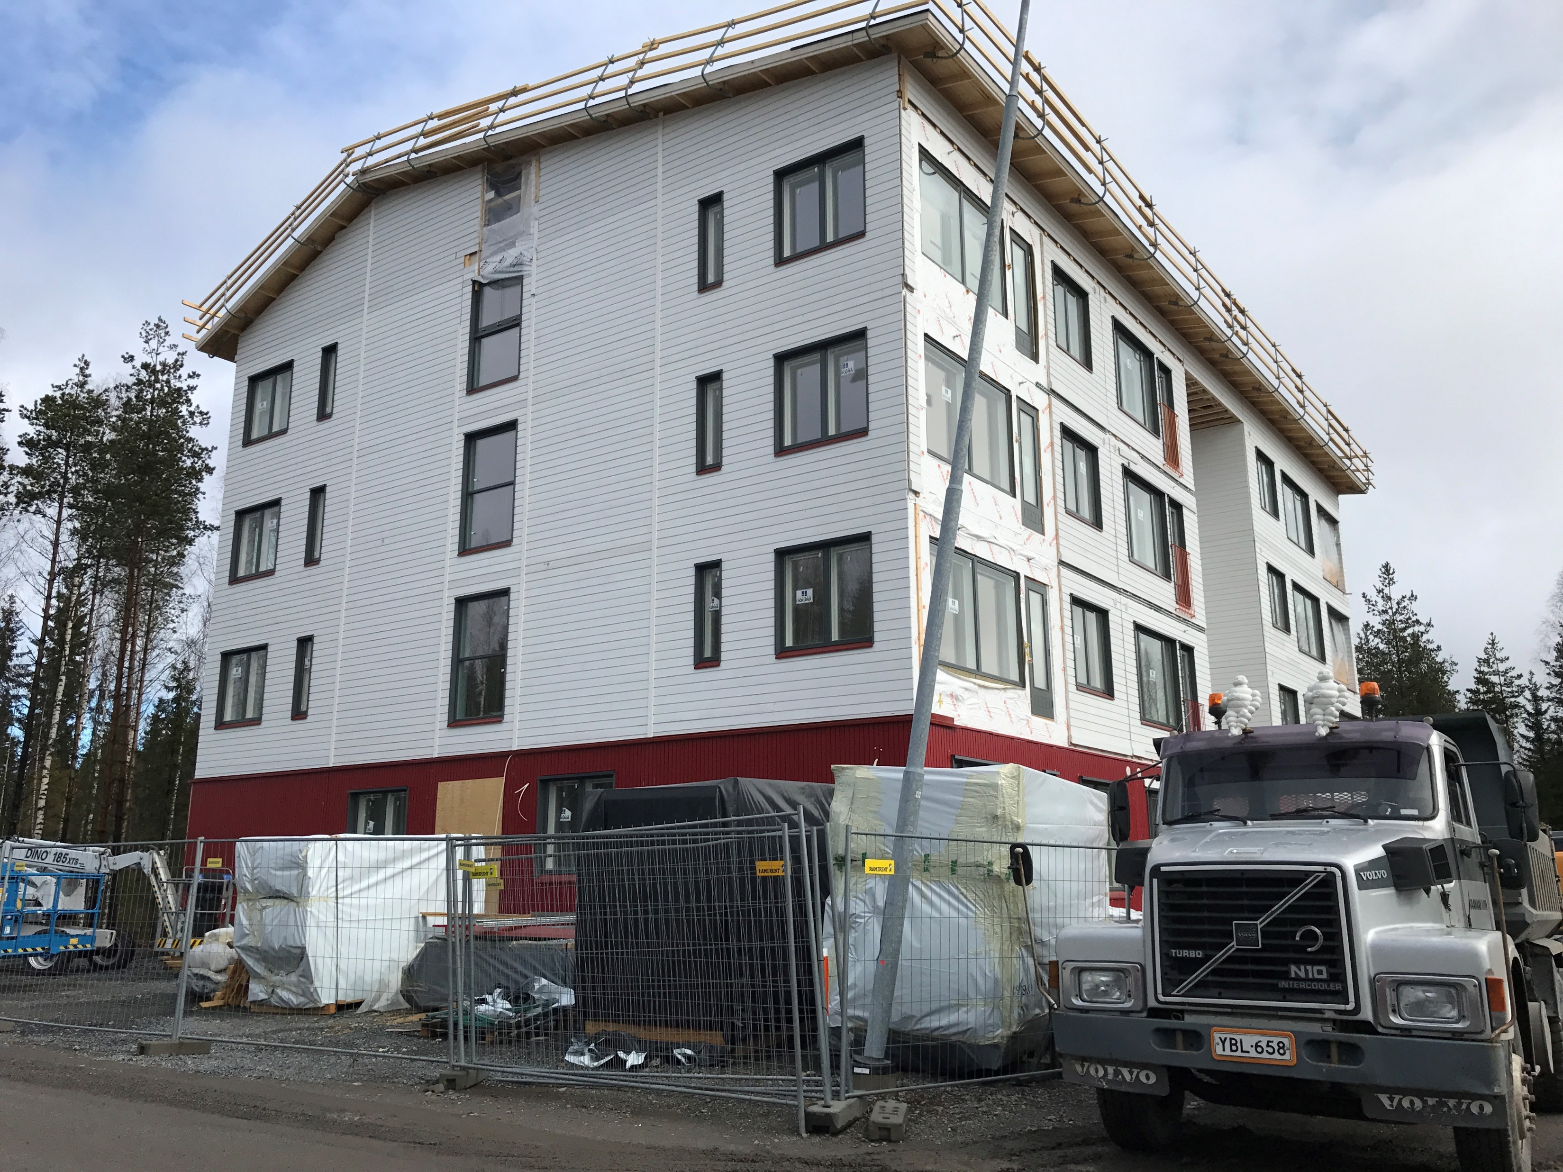
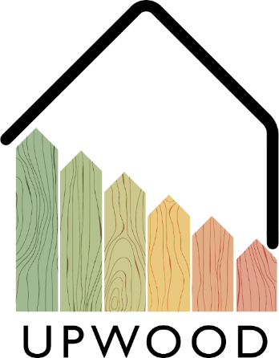
03-1/ LU2: TIMBER CONSTRUCTION, RENOVATION AND DECONSTRUCTION
PERFORMANCE AND DURABILITY OF WOODEN STRUCTURES

Slide 2
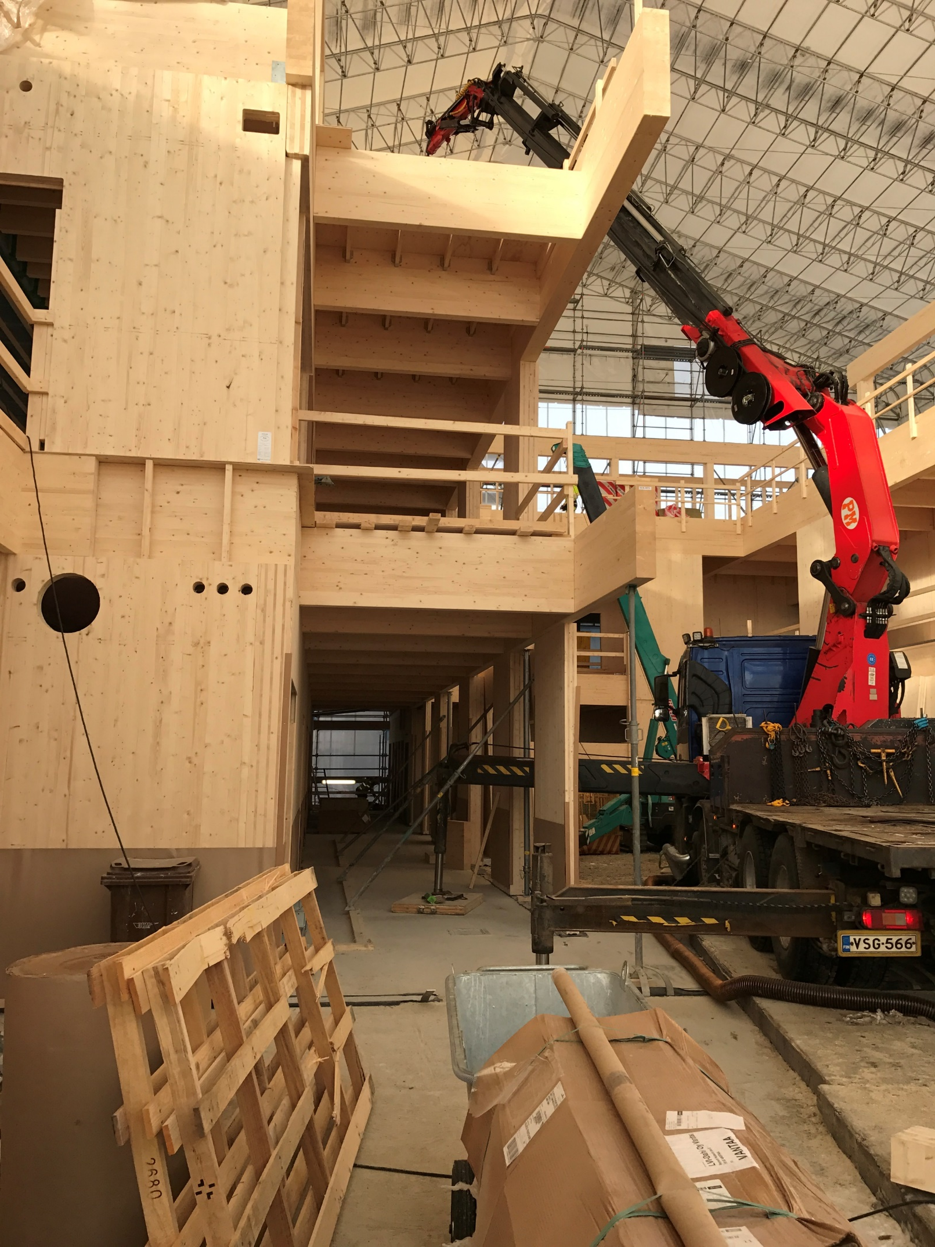
PRESENTATION OVERVIEW
Topics covered
Introduction
Environmental aspects
Benefits
Durability of wood structure
EN & Eurocode standards
Frequently asked questions

Slide 3
Introduction
The basic function of a load-bearing timber structure is to transfer the unladen load, payload, snow load and wind load to the foundation of the building.
The joining methods used in wooden structures must be determined in accordance with the above-mentioned loads, and the joining methods are therefore of key technical and architectural importance.
In wooden joints, two or more structural parts are connected to each other in such a way that, under the action of an external force, the joint resists the parts coming apart or sliding relative to each other.
3

Slide 4
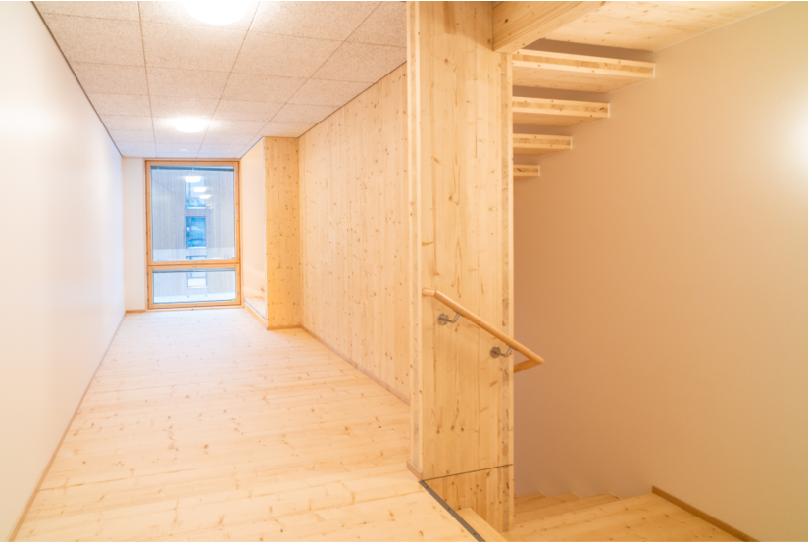
Environmental aspects
As a natural material, wood has a strength that depends on moisture and stress time, so the strength of wood is greatest when dry and with a short-term load.
Wood has good construction technical properties and the versatility of wood as a building material is well illustrated by the fact that it can be used as both a load-bearing and surface-forming material, but the wood material also acts as a thermal insulator.
The wooden surface is felt to be pleasant and warm. Wood as a building material is light and easy to work with.
Many wood structures are more economical than massive structures made of other materials, and no substances that are hazardous to health evaporate from the wood.
Wood is a clean, renewable natural product whose by-products during production, but also the construction waste at the end of its life cycle, return to their environment without polluting nature.
4

Slide 5
Benefits
PRODUCTIVITY
EFFICIENCY
The incorporation of wood material by different methods brings speed to the production process.
The processing of raw wood material has a long history. Based on its expertise, more efficient new technology processing solutions can be created.
ENVIRONMENT
COSTS
Wood is an easy-to-process material with waste and side streams that can be further processed.
The competitiveness of wood in the cost comparison has remained fairly good. Wood structures use wood produced nearby, which reduces transport costs.

Slide 6
Durability of wood structure
The wooden structure, when protected and installed correctly, has good durability and service life.
It is possible to protect against water by protecting the wooden structure, for example with a waterproof roof, so that the wood material cannot get wet, at the same time this reduces damage to biological factors, because dry wood is more resistant to exposure.
The wooden structure should also be protected from weather conditions such as sunshine, wind or rain.
The durability of a wooden structure can be significantly affected by choosing the right type of wood for the right target. For example, spruce is suitable for exterior cladding, or larch for easily wet areas such as patios or exterior stairs, but poorly indoors due to numerous resin pockets.
6

Slide 7
EN & Eurocode standards
Timber structures are designed in accordance with standard EN 1990: 2002 so that the relevant national basic requirements are also met.
The basic requirements are considered to be met when using the limit state dimensioning and the partial safety factor method according to the national annex of Eurocode 0.
The loads and their combinations are determined according to Eurocode 1 and its national annex.
For durability, serviceability and shelf life, Eurocode 5 and its national annex shall be followed.
7

