Slide 1
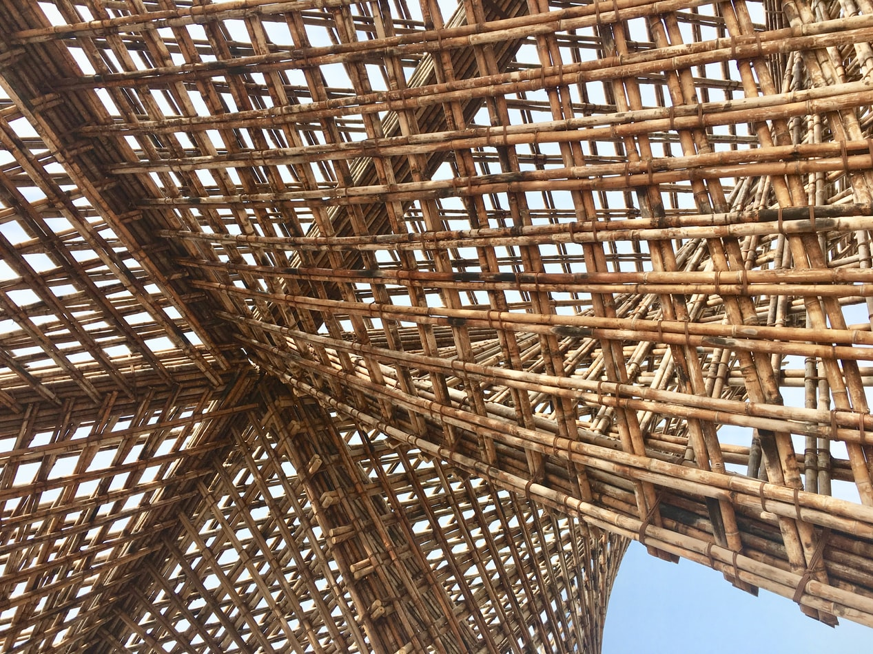

UNIT 3:
Lesson 6
Fire safety of timber buildings – Basics of fire engineering

Slide 2
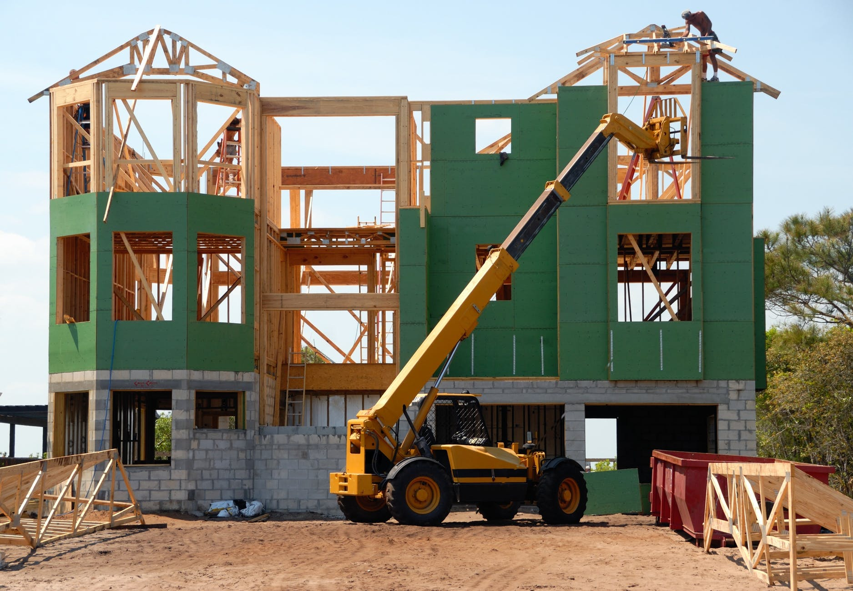
Presentation Overview
TOPICS TO BE DISCUSSED
Terms and definitions
Nominal temperature-time curves
Fire load density
Reaction to fire classification
Limitations of calculation method
- Fire resistance prediction method using calculations
- Fire resistance classification
LESSON 6: Fire safety and protection solutions

Slide 3
Fire resistance Calculations according Eurocode 5 Part 1-2 and Technical guideline for Europe
SP Report 2010:19
Terms and definitions
Fire compartment – space within a building, extending over one or several floors, which is enclosed by separating elements such that fire spread beyond the compartments is prevented during the relevant fire exposure;
Fire resistance – ability of structure to fulfil its required function (load bearing and/or fire separating function) for a specified fire exposure and period of time;
Separating element – load bearing or non-load bearing element (e.g. wall) forming part of the enclosure of a fire compartment;
3
LESSON 6: Fire safety and protection solutions

Slide 4
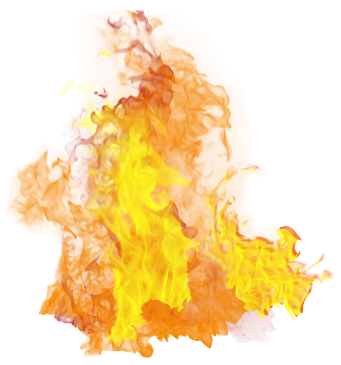

Nominal temperature time curves according Eurocode 1 Part 1-2
Theoretical fires
Standard temperature-time curve
$$θ_{g}=20+354\log_{10}(8t+1)$$
4
LESSON 6: Fire safety and protection solutions

Slide 5
Nominal temperature time curves according Eurocode 1 Part 1-2
Theoretical fires – Standard charring rates
Standard Charring rates of timber materials
5
LESSON 6: Fire safety and protection solutions

Slide 6
Nominal temperature time curves according Eurocode 1 Part 1-2
Theoretical fires
External fire temperature-time curve
$$θ_{g}=660\left(1−0,687e^{−0,32t}−{0,313e}^{−3,8t}\right)+20$$
6
LESSON 6: Fire safety and protection solutions

Slide 7


Nominal temperature time curves according Eurocode 1 Part 1-2
Theoretical fires
Hydrocarbon fire temperature-time curve
$$θ_{g}=1080\left(1−0,325e^{−0,167t}−0,675e^{−2,5t}\right)+20$$
7
LESSON 6: Fire safety and protection solutions

Slide 8
Nominal temperature time curves according Eurocode 1 Part 1-2
Real fires
Real fire temperature-time curves
Temperature/ Heat release rate
Fire ignition and development phase
Fully developed fire
Temperature curve for uncontrolled fires
Fire curve for controlled fires
Flashover
Cooling phase
Smouldering fires
Time
8
LESSON 6: Fire safety and protection solutions

Slide 9
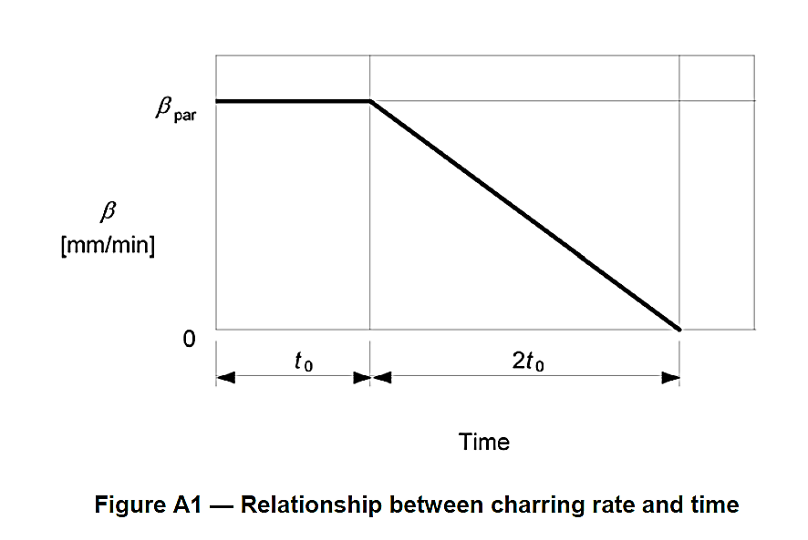
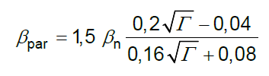
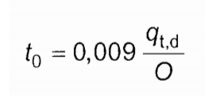
Parametric temperature-time curve for compartment fires
Nominal temperature time curves according Eurocode 1 Part 1-2
Advanced Theoretical fires
9
LESSON 6: Fire safety and protection solutions

Slide 10
Fire load density
Fire characteristics
Fire load density
Parametric temperature-time curves and timber charring rates can be calculated when available energy for combustion on every floor square meter in the room is known.
There are two types fire loads:
Movable fire loads (such as furniture and other combustible materials brought in room);
Permanent fire load (such as combustible linings, claddings and structures)
Permanent fire load can be calculated using calculation procedure given in EN 1991-1-2 Annex E.
Movable fire loads usually are characterised by occupancy class of the building. The way how use the building defines how many combustible materials we bring in.
For typical occupancies fire load densities can be obtained from tabulated values;
In all other cases, the engineer have to do a survey
10
LESSON 6: Fire safety and protection solutions

Slide 11
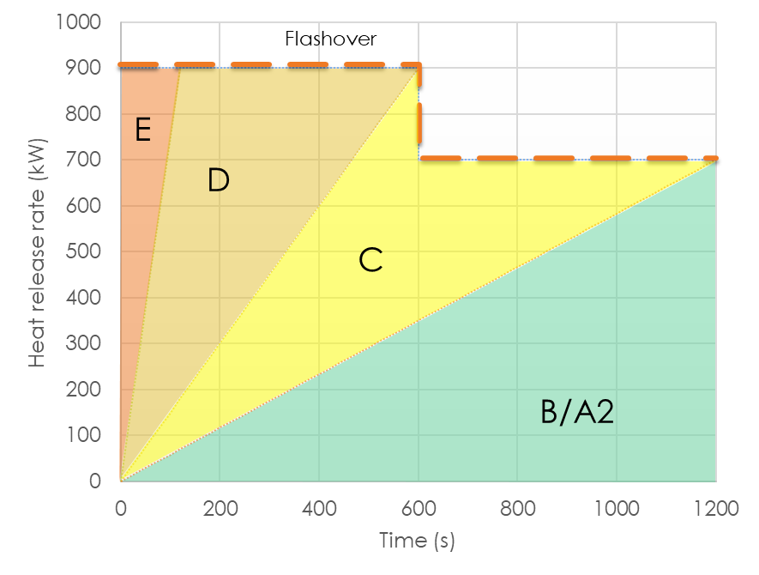
Fire load density
Fire characteristics
Reaction to fire
Idea about which construction product is combustible and therefore contributes to fire load and which is not, can be obtained from reaction to fire class
Construction products with class B and below can be assumed to be combustible.
Reaction to fire class shows how quickly product becomes engulfed in fire
11
LESSON 6: Fire safety and protection solutions

Slide 12
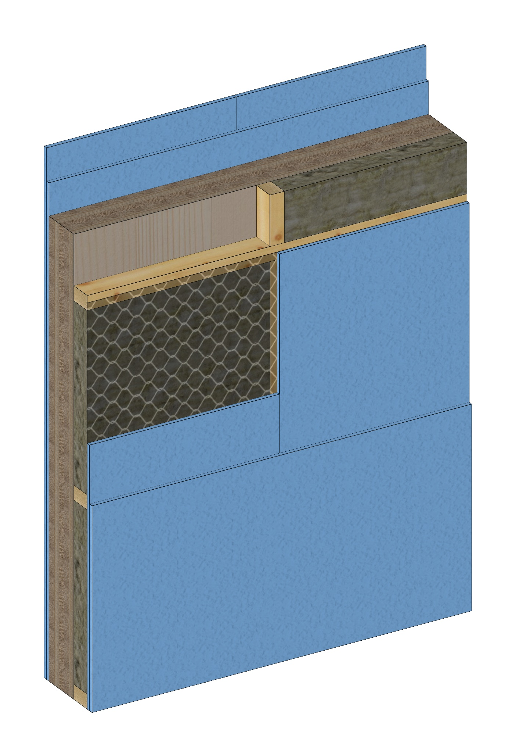



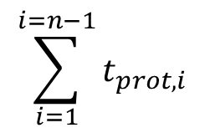
Improved calculation method for fire separating timber walls
Layer n
Layer n-1
The design method is based on the additive component method given in EN 1995-1-2. The total fire resistance is therefore taken as the sum contributions from the different layers, considering different heat transfer paths and according to their function and interaction.
$$t_{ins}=\sum_{i=1}^{i=n−1}{t_{prot,i}+t_{ins,n}}$$
$$\left(1\right)$$
where
Layer i
$$\sum_{i=1}^{i=n−1}{t_{prot,i}}$$
Sum of the protection times t_{prot,i} of the layers (in the direction of the heat flux) preceding the last layer of the assembly on the side not exposed to fire [min];
$$t_{ins,n}$$
Insulation time t_{ins,n} of the last layer of the assembly on the side not exposed to fire [min].
Layer 1
12
LESSON 6: Fire safety and protection solutions

Slide 13

Fire resistance classification
Layer n
Layer n-1
From calculation it is estimated that separating wall comprising of cross-laminated timber (CLT) covered with double layer F type gypsum plasterboards from both sides and sound insulation layer from exposed side with reinforcement steel mesh to prevent mineral wool failure during fire exposure could serv as fire separating element for approximately 124 minutes.
$$t_{ins}=\sum_{i=1}^{i=n−1}{t_{prot,i}+t_{ins,n}=124,9 (min)}$$
Classification (2000/367/EC)
Applies: | Separatin non-load bearing structures
References | EN 13501-2; EN 1364-3,4,5,6; EN 1992-1.2; EN 1993-1.2; EN 1994-1.2; EN 1995-1.2; EN 1996-1.2; EN 1999-1.2
Classification: | Available classification marked with green
E |  | 20 | 30 |  | 60 | 90 | 120
EI | 15 | 20 | 30 | 45 | 60 | 90 | 120 | 180 | 240
EI-M |  |  | 30 |  | 60 | 90 | 120 | 180 | 240
EW |  | 20 | 30 |  | 60 | 90 | 120
Layer i
Layer 1
13
LESSON 6: Fire safety and protection solutions

Slide 14
Limitations:
Improved design method for separating function of timber constructions consider following construction products:
Solid timber, glued laminated timber and cross-laminated timber with characteristic density ≥ 290 kg/m³;
Laminated Veneer Limber (LVL) with characteristic density ≥ 480 kg/m³;
Oriented Strand Board (OSB) with characteristic density ≥ 550 kg/m³;
Plywood according to EN 636 with characteristic density ≥ 400 kg/m³;
Gypsum plasterboards type A, H and F according EN 520;
Mineral wool insulation according to EN 13162
Calculation method is informative and gives indicative values of what might be fire resistance properties of simple and complex timber walls
METHODS
Since calculation method is informative, national fire protection design provisions shall be followed
LESSON 6: Fire safety and protection solutions

Slide 15
References
Noteikumi par Latvijas būvnormatīvu LBN 201-15 "Būvju ugunsdrošība" MK 2015.gada 30. jūnija noteikumi Nr.333. - https://likumi.lv/ta/id/275006-noteikumi-par-latvijas-buvnormativu-lbn-201-15-buvju-ugunsdrosiba
INSTA TS 950, Fire Safety Engineering - Comparative method to verify fire safety design in buildings. February 24, 2015
EAD 130005-00-0304 “Solid wood slab element for use as structural element in buildings”; 2015-07
EN 1991-1-2:2002 Eurocode 1: Actions on structures - Part 1-2: General actions - Actions on structures exposed to fire
EN 1995-1-2: Eurocode 5: Design of timber structures - Part 1-2: General - Structural fire design
EN 13501-1:2018 Fire classification of construction products and building elements - Part 1: Classification using data from reaction to fire tests
EN 13501-2:2016 Fire classification of construction products and building elements - Part 2: Classification using data from fire resistance tests, excluding ventilation services
SP Technical Research Institute of Sweden – SP Report 2010:19. Fire safety in timber buildings. Technical guideline for Europe. ISBN 978-91-86319-60-1 – 211 p.
JOURNALS AND PUBLICATIONS
Babrauskas V., Ignition Handbook: Principles and applications to fire safety engineering, fire investigation, risk management and forensic science. - Issaquah, WA : Fire Science Publishers, 2003. - 1116 p.
Purkiss J.A., Fire Safety Engineering : Design of Structures, 2nd Edition. - New Delhi, India: Elsevier, 2007. – 389 p.
Fontana M., Kohler J., Fischer K., De Sanctis G.. Fire Load Density / SFPE Handbook of Fire Protection Engineering 5th Edition – New York : Springer, 2016 – p. 1131-1142.
Boverket Handbok, Brandbelastning, 2008. Available: https://www.boverket.se/globalassets/publikationer/dokument/2008/brandbelastning_3.pdf
15
LESSON 6: Fire safety and protection solutions

