Slide 1
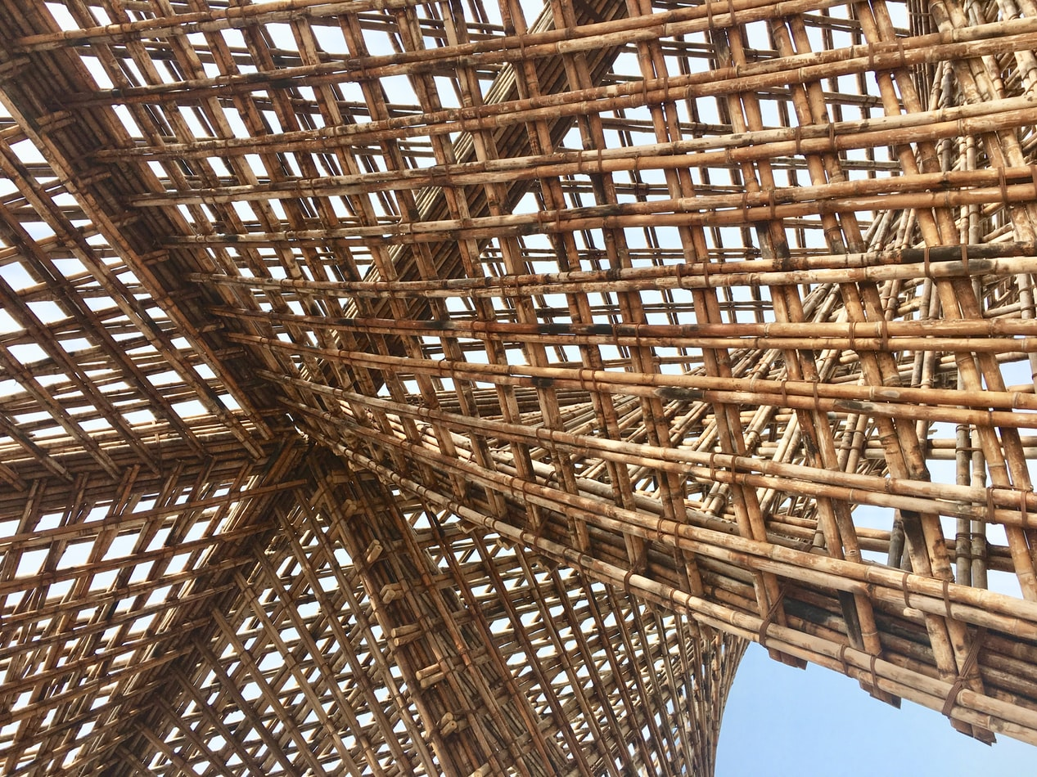
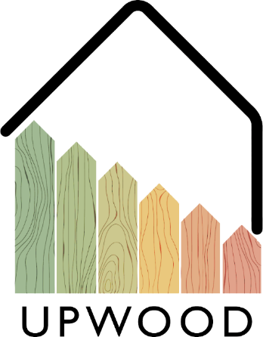
LEARNING UNIT 1:
Lesson 3
Availability and environmental friendliness of wood as building material

Slide 2
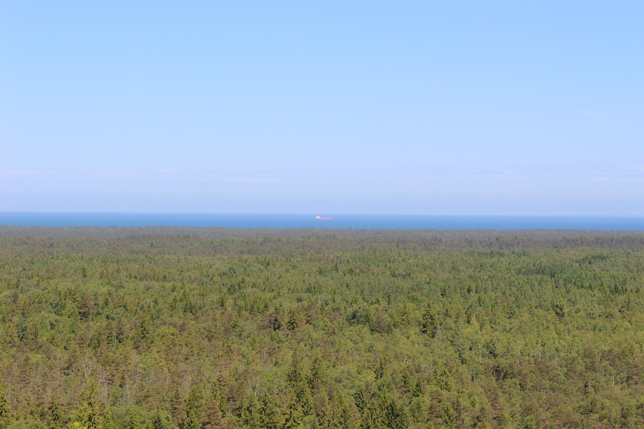
Presentation Overview
TOPICS DISCUSSED
The forests - sustainable forestry in partnership countries
Certification schemes in partnership countries
Wood species used as structural timber
Building structural materials – in general
Overview of glued wooden construction materials
LESSON 3: Availability and environmental friendliness of wood as building material

Slide 3
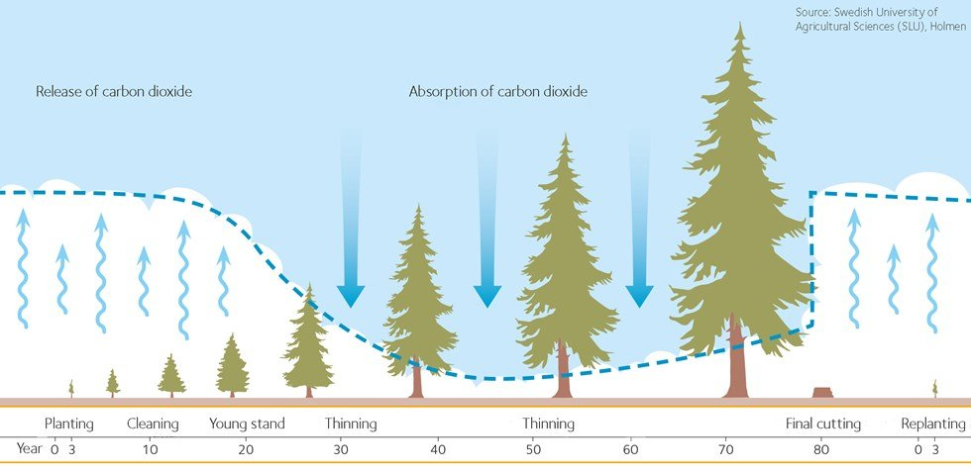
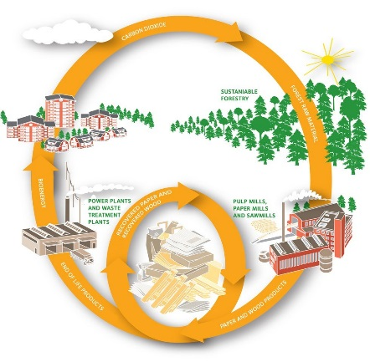




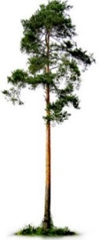

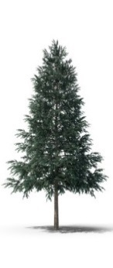
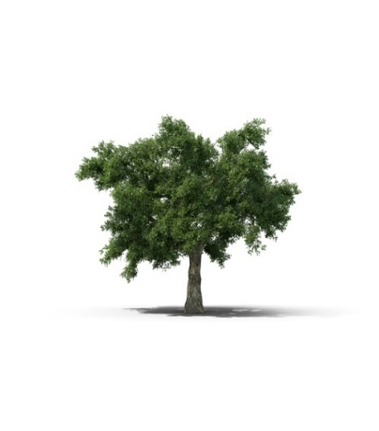
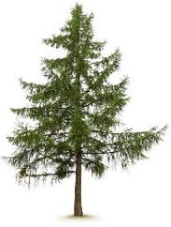
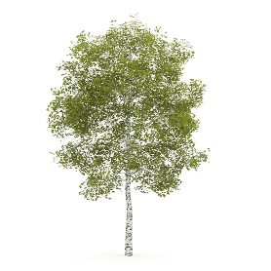
SUSTAINABILITY
The world`s most vital formula:
6H₂O + 6CO₂ + solar energy → C₆H₁₂O₆ +n 6O₂
If we ignore Mother Nature’s rules, we will be sadly disappointed to find that our buildings succumb to Father Time.
FORESTRY IN PARTNERSHIP COUNTRIES
Austria
Forest cover 46,2%
Growing stock is 972 million m³
Yearly increment 31,4 million m³
Yearly felling 19,8 million m³
Main species: Norway spruce 59,8%; Beech 9,5%; Scots pine 6,2%
Finland
Forest cover 71,6%
Yearly increment 110 million m³
Main species: Scots pine 50%;
Norway spruce 30%; Hardwoods 20%
Greece
Forest cover 19%
Softwood in forests 38%; Hardwoods 62%
Sustainability
Certification schemes
Wood species for structures
Latvia
Forest cover 53%
Yearly increment 25 million m³
Yearly felling 11 million m³
Main species: Scots pine 33%;
Birch 30%; Norway spruce 19%; other hardwoods 18%
CERTIFICATION SCHEMES
Forest Stewardship Council
FSC is an independent, non-governmental organization established to promote responsible management of the world’s forests. The FSC program includes two types of certifications:
Forest Management Certification
Chain-of-Custody (COC).
WOOD SPECIES
Spain
Forest cover 29%
Main species are pines,
Eucalyptus, oak and beech, silver fir.
Programme for the Endorsement of Forest Certification
The Programme for the Endorsement of Forest Certification scheme was developed to address this issue and serves as an umbrella endorsement system that provides international recognition for national forest certification programs.
Founded in 1999, the PEFC represents most of the world’s certified forest programs and the production of millions of tons of certified timber.
Scots pine
(Pinus silvestris L.)
Norwy spruce
(Pices abies L. H. Karst.)
Oak
(Quercus robur L.)
Larch
(Larix Mill.)
Birch
(Betula ... L.)
https://www.swedishwood.com
http://www.fao.org/3/w3722E/w3722e05.htm
https://www.forestindustries.fi/statistics/forest-resources-and-wood-raw-material/
https://www.climatechangepost.com/greece/forestry-and-peatlands/
https://www.zm.gov.lv/public/ck/files/ZM/mezhi/skaitlifakti_ENG20.pdf
http://www.fao.org/forestry/country/57478/en/esp/
www.fsc.org; https://www.pefc.org/; www.unece.org
https://ec.europa.eu/environment/forests/timber_regulation.htm
3
LESSON 3: Availability and environmental friendliness of wood as building material

Slide 4
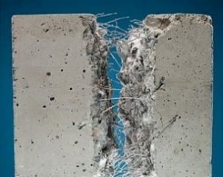
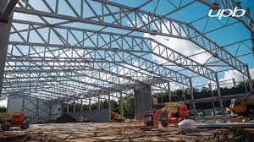
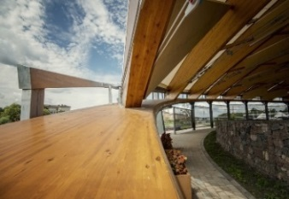
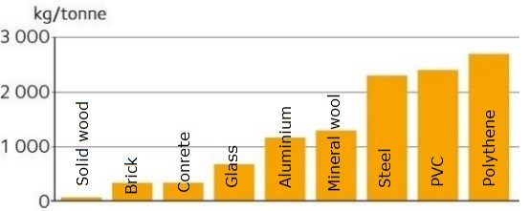
Wood is 21st Century’s material because:
wood is renewable and costless to produce than steel and concrete,
wood stores carbon, does not require huge amounts of energy for production,
wood has great acoustic and thermal properties,
wood construction technologies are enabling the tall and modern buildings,
protected wood will last for hundreds of years and can be repaired, refinished and recycled,
the waste from production is also useable for wood-based panels production or many others,
once the service life of wood is ended, it is 100% biodegradable and can be used as a fuel.
BUILDING STRUCTURAL MATERIALS 1/3
REINFORCED CONCRETE
STRUCTURAL STEEL
WOOD
In general
Advantages:
compressive and tensile strength;
fire resistance;
durability;
in structure like footings, dams, piers etc. reinforced concrete is the most economical construction material;
user-friendliness.
Disadvantages:
long-term storage;
curing time;
cost of forms;
shrinkage (causes crack development and strength loss).
Advantages:
steel has a high strength/weight ratio;
ductility;
speed of erection;
ease of repair;
repetitive use;
expanding existing structures.
Disadvantages:
general cost;
fireproofing;
maintenance.
Advantages:
tensile strength in fiber direction;
electrical and heat resistance;
sound absorption;
locally sourced;
environmentally friendly.
Disadvantages:
shrinkage and swelling;
wood is a hygroscopic material;
endurable (biological, non-biological) agents if not protected.
Carbon emission from manufacture of construction materials
https://civildigital.com/fiber-reinforced-concrete/
www.upb.lv
www.iktk.lv
https://www.swedishwood.com/wood-facts/about-wood/wood-and-the-environment/wood-is-a-sustainable-construction-material/
4
LESSON 3: Availability and environmental friendliness of wood as building material

Slide 5
Content of components of the Wood Based Materials
Content of
Wood Based Materials
GLUED WOODEN CONSTRUCTION MATERIALS
Wood or other wooden - materials such as straw, reeds
Adhesives
synthetic adhesives urea (formaldehyde resin); phenol formaldehyde resin; isocyanate adhesives
mineral adhesives;
glue derived from wood components (lignin, tannins etc.)
Additives
wax
wood protection products protectors against ignition
other additives (paints etc.)
Classification of Wood materials and Wood Based Panels
Wood materials
Materials from
Solid wood
Glued Laminated Timber (GLT)
Cross Laminated Timber (CLT)
Solid wood boards
Materials form
Veneers
Plywood
Laminated Veneer Lumber (LVL)
Parallam
Materials from
Chips
Wood Particle Board
Orientated Strand board (OSB)
Scrimber;
Laminated Strand Lumber (LSL)
Materials from
Fibers
Wood Fiber Boards for Insulation (LDF)
Middle Density Fiber Boards (MDF)
High Density Fiber Boards (HDF)
Combined materials
I-beams
Wood construction board
Lightweight stabilised block board panels
Overview
Influence of the size of structural elements on the material properties
Property/ Characteristic | Solid Wood | Glued Structural Timber
strength
thermal insulation
surface quality
homogeneous
isotropy
energy consumption
environmental impact
Kruse K., Venschott D. Eigenschaften und Einsatzpotentiale neuer Holzwerkstoffe im bauwessen, 2001
Feller 1999
5
LESSON 3: Availability and environmental friendliness of wood as building material

Slide 6
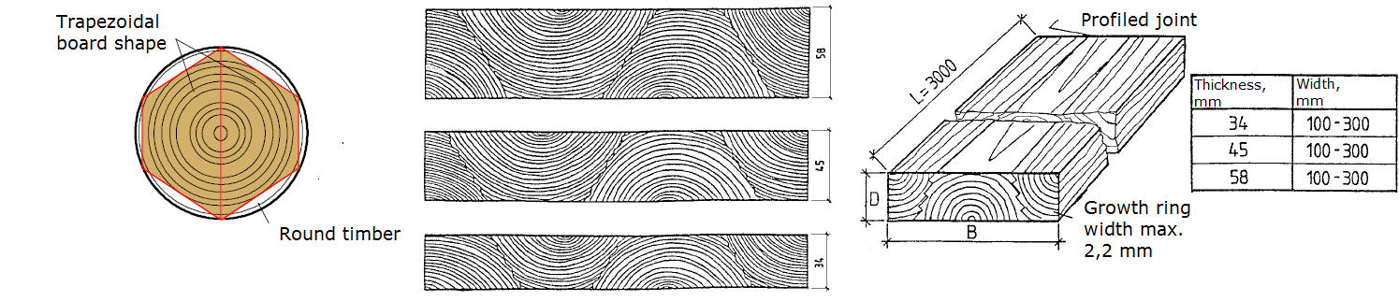
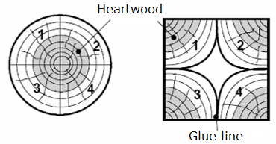
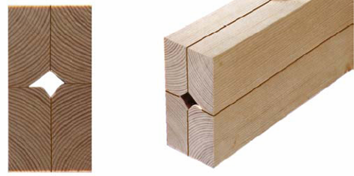
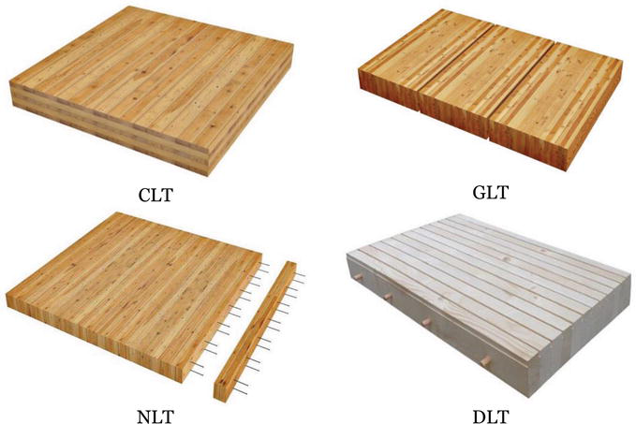
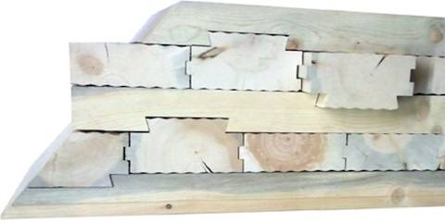
Lumber based materials
GLUED WOODEN CONSTRUCTION MATERIALS 1/4
Panel type
Single layer
Multi-layer
Lumber type
Glued solid wood
Glued wood lamellas
Jointed type
Beams with holes
Combine with sound or thermal insulation
Requirements for the creation of these materials:
wood of quality and strength of wood must be used in the outer layers,
a finger joint is used to connect individual elements in length, stick joint in some places allowed,
odd layers form symmetrical with respect to the central-neutral axis of the material,
the location of the growth rings in sticking layers must be compensating.
Creation of the single-layer solid wood panels
Lumber based materials
Small diameter roundwood for beam production
GLT and glue-less laminated timber
http://www.treehugger.com/sustainable-product-design/interlocking-cross-laminated-timber-could-use-square-miles-beetle-killed-lumber.html
7.%20 Neue%20 Holzwerkstoffe%20S.7.1_ 7.12.pdf
6
LESSON 3: Availability and environmental friendliness of wood as building material

Slide 7
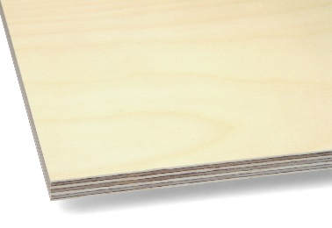
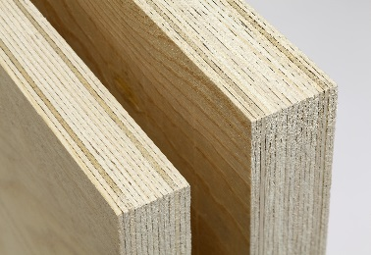
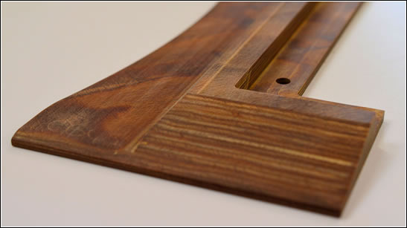
Veneer based materials
GLUED WOODEN CONSTRUCTION MATERIALS 2/4
Densified/ Undensified
Plywood (U)
Laminated Veneer Lumber (U)
Bakelite plywood (D)
Veneer type
Full veneer sheet (plywood, LVL)
Veneer stripes (Parrallam)
Orientation of Veneers
90° each other (plywood)
Parallel fibers (LVL)
Different ways (special plywood)
Birch veneer-surfaced plywood surface quality class:
A (E) - flawless special quality (only available to a limited extent).
B (I) - lacquered or waxed surface.
S (II) - paintable surfaces.
BB (III) - normal quality, for example under coverings, the most common quality in structures.
WG (IV) - for less demanding applications, a quality that cannot be repaired
Veneer based materials
Veneer based materials
Plywood LVL Bakelite
As a construction material plywood can be used for:
roof substructures
subfloor boarding
stiffening boarding for wall and load-bearing structures
interior lining
balcony floors
scaffolding platforms
concrete moulds
building site fences
https://www.finieris.com/en/products/plywood/raw-plywood/riga-ply
https://www.woodproducts.fi/metsa-wood-kertor-lvl-qp-beam
https://www.storaenso.com/en/newsroom/news/2020/6/developing-a-lignin-based-resin-for-plywood
https://www.woodproducts.fi/content/plywood
7
LESSON 3: Availability and environmental friendliness of wood as building material

Slide 8
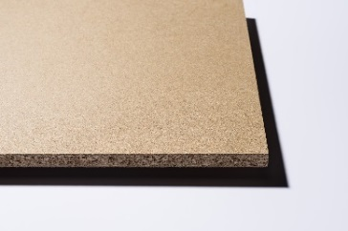
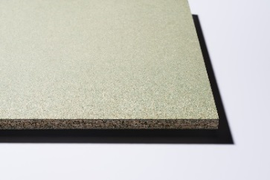
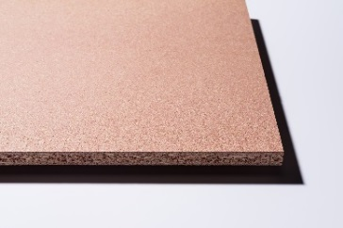
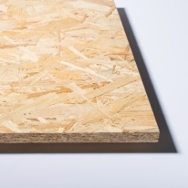
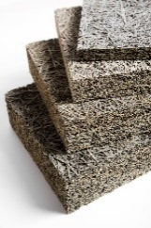
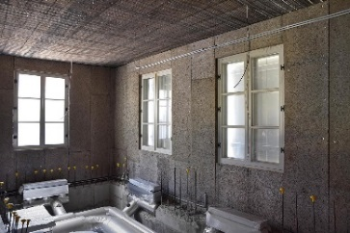
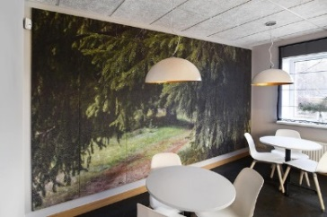
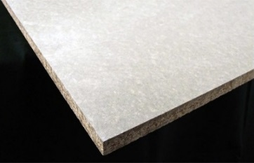
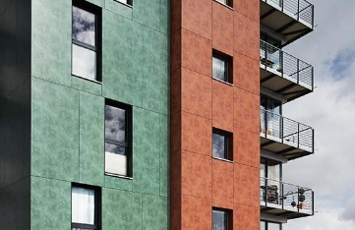
Wood Particle board (WPB) and Oriented Strand Board (OSB)
GLUED WOODEN CONSTRUCTION MATERIALS 3/4
Particleboards classification (EN 312):
P1 - Construction boards for interior use.
P2 - Furniture boards for interior use.
P3 - Non-load-bearing use, a board that withstands moisture better than standard particle board.
P4 - Boards that can withstand stress, for interior use.
P5 - For applications that need to withstand stress, a board that withstands moisture better than standard particle board.
P6 - Floor boards that can withstand severe stress, for interior use.
P7 - For applications that need to withstand severe stress, a board that withstands moisture better than standard particle board.
OSB classification (EN 300):
OSB 1 - general purpose boards, suitable for interior use, including furniture production.
OSB 2 - construction boards for indoor use in dry operating conditions.
OSB 3 - structural boards for use in wet operating conditions.
OSB 4 - for use of heavy-duty structural boards in wet operating conditions.
Particle-based materials
Some products particle board products
Fibrolite
Cement bonded WPB
https://lv.kronospan-express.com/lv
https://europanels.org/the-wood-based-panel-industry/types-of-wood-based-panels-economic-impact/oriented-strand-board/
https://www.cewood.com/
8
LESSON 3: Availability and environmental friendliness of wood as building material

Slide 9
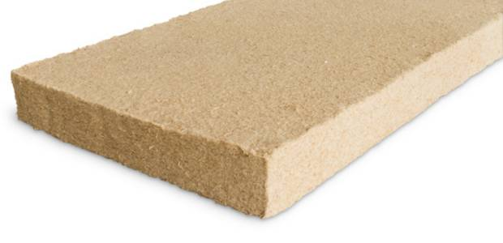
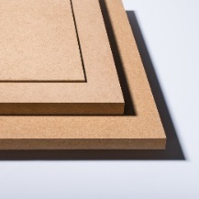
Wood Fiber Board
Standard wood fibre board can be divided into two main categories:
porous (used for thermal insulation).
hard (MDF, HDF – for floors etc.).
GLUED WOODEN CONSTRUCTION MATERIALS 4/4
Wood Based Panels properties
Moisture content of glued wood construction materials
(temp. 20°C, rel. humidity 65%)
Wood based material | Moisture content, %
Plywood | 8 to 10
Particle board (pressed by flat press) | 9±4
Particle board (pressed by extrusion press) | 9±4
HDF | 5±3
MDF | 9±4
Properties of glued wood based construction materials
Fiber-based materials
&
Wood Based Panel
properties
Property | Solid wood | Plywood | LVL | OSB | Particle board | MDF | LSL | PSL
Density, kg m⁻³ | 450 | 500-600 | 660-700 | 660-700 | 680-700 | 760-790 | 650 | 660
E-modulus, N mm ⁻² | - | - | - | - | 2600-3200 | 4000-4500 | 12000 | 14000-15500
parallel | 5000-7000 | 12000 | 13000-16000 | 7000 | - | - | - | -
perpendicular | 1000-3000 | 7000 | - | 1850 | - | - | - | -
Bending strength, N mm ⁻² | - | - | - | - | 20-22 | 33-38 | - | -
parallel | 30-50 | 80 | - | 36 | - |  | - | 60-65
perpendicular | 10-30 | 40 | - | 20-25 | - | - |  | -
Shear modulus N mm ⁻² | - | - | - | - | - | - | - | -
flat | 200 | - | 500 | 300 | 100-180 | 100-200 | - | 700-800
accros | 600-700 | - | 500 | 1100 | 1000-1500 | 600-1000 | 2300 | -
http://www.euroform.co.uk/
http://steico.eu/
https://lv.kronospan-express.com/lv
https://www.woodproducts.fi/content/wood-fibre-board
9
LESSON 3: Availability and environmental friendliness of wood as building material

Slide 10
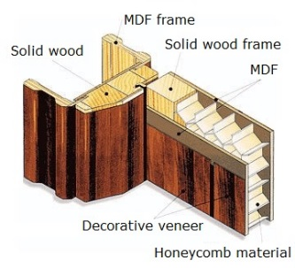
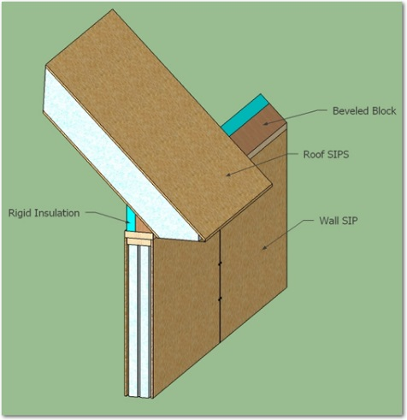
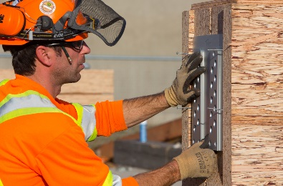
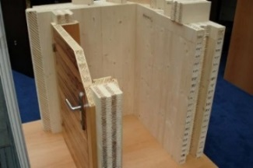
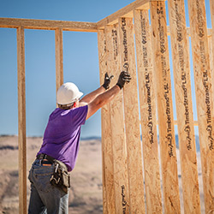
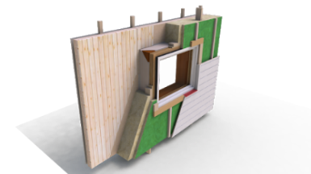
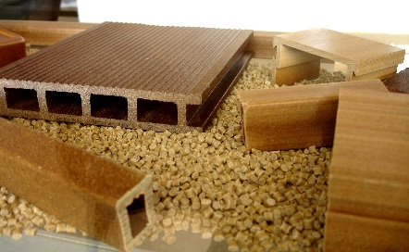
Connective wood materials
COMBINED WOODEN MATERIALS
Middle layer form solid wood
Middle layer from particle board
Middle layer from wood cellular material
Middle layer from foam material
I joist with
OSB web
Honeycomb
material
Structural isolated
panel SIP
Parallel Strand
Lumber
DendroLight
Laminated Strand
Lumber (LSL)
DendroLight®
building block
Wood plastic
composites
Not modern –
less material.
less energy.
lower workload
https://www.foamlaminates.com/sips-structural-insulated-panels/
https://www.metsawood.com/global/Products/finnjoist/applications/Pages/default.aspx
http://www.honeycomb.lv/
https://materialdistrict.com/material/dendrolight-door-blank/
https://materialdistrict.com/material/dendrolight-building-block-bb/
http://dendrolight.lv/en/products/building-systems/
10
LESSON 3: Availability and environmental friendliness of wood as building material

Slide 11
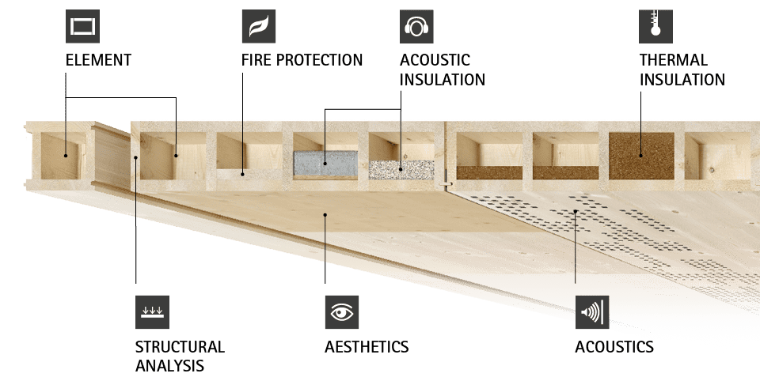
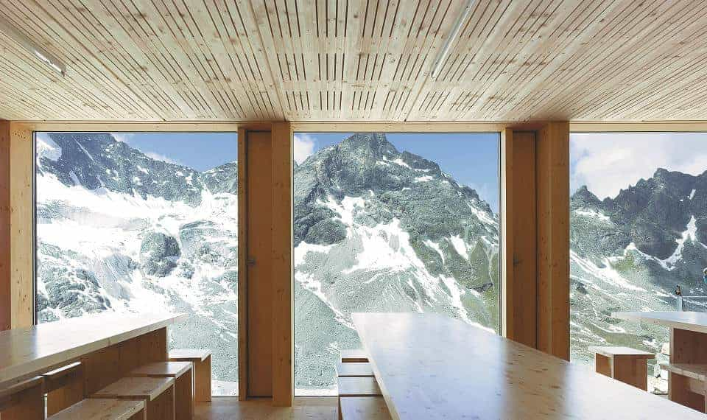
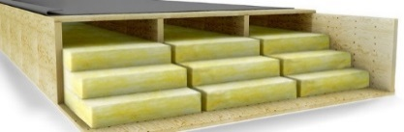
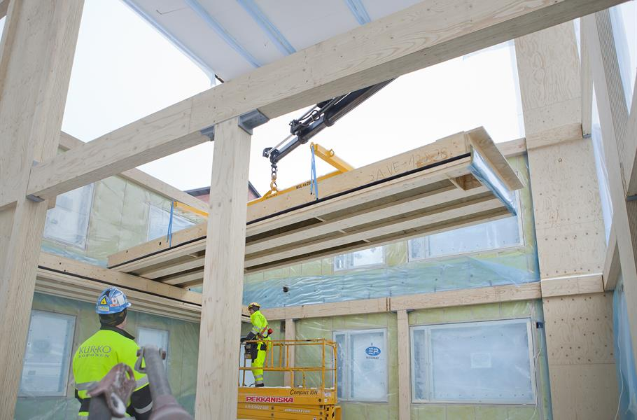
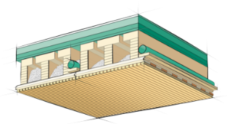
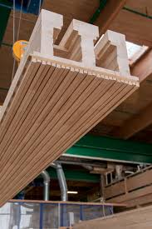
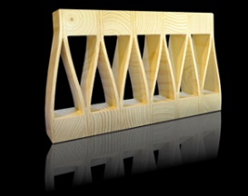
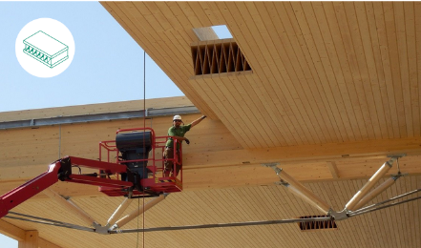
LIGNATUR (click on the left hand picture)
BUILDING PANEL SYSTEMS
Kerto-Ripa® (click on the left hand picture)
LIGNO (click on the left hand picture)
KIELSTEG (click on the left hand picture)
https://www.metsawood.com/global/Products/kerto/applications/Pages/Wood-elements.aspx
https://www.lignotrend.de/home/
http://www.kielsteg.at/was-ist-kielsteg/
https://www.lignatur.ch/en/product
11
LESSON 3: Availability and environmental friendliness of wood as building material

Slide 12
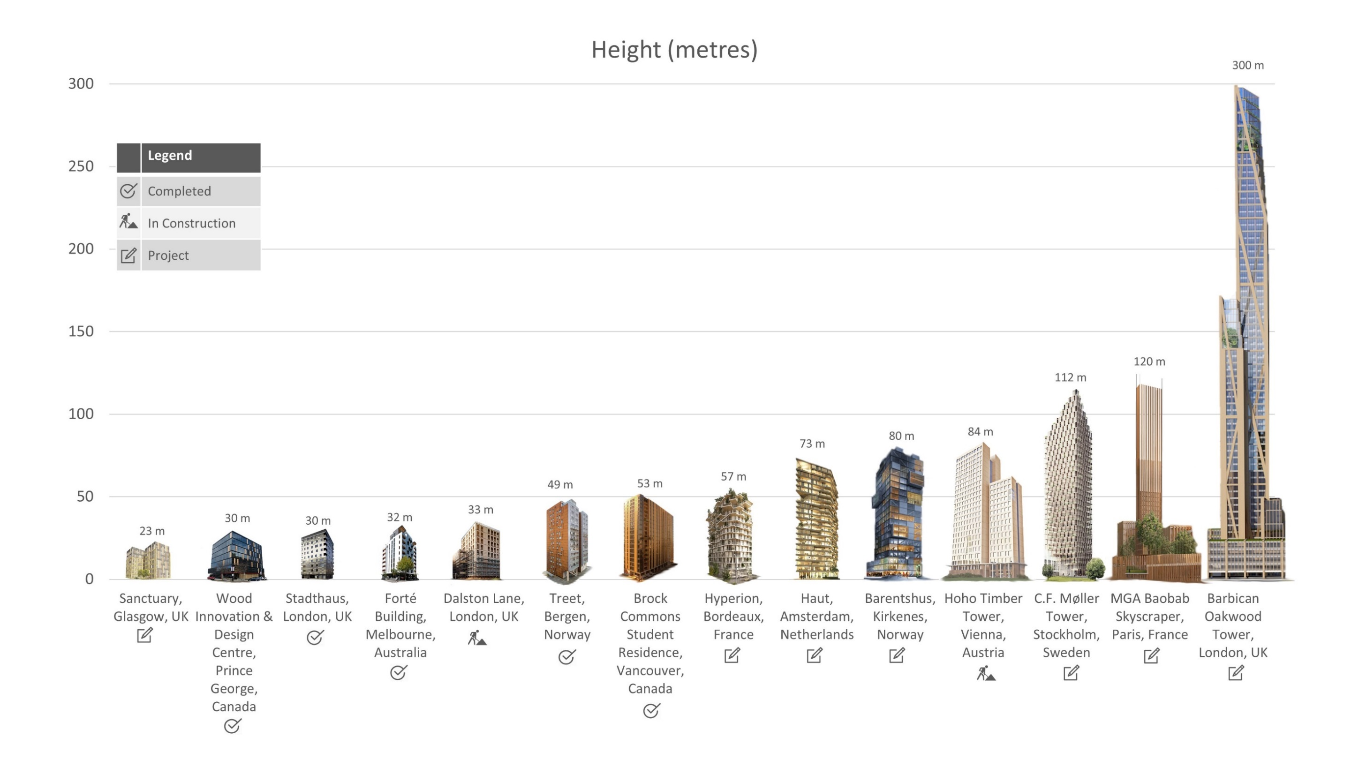
Limitations:
THERE ARE NO LIMITS IF WE THINK ABOUT THE WOOD -
WOOD is:
SMART
WARM
ENVIRONMENTALLY FRIENDLY
RENEWABLE
EASY TO PROCESS
EASY TO BUILD
and thanks to You...
could be the highest!
http://www.hoho-wien.at/getattachment/350c225d-e804-400f-aa88-12b75d6e7e41/timber-skyscrapers-infographic-web.jpg
LESSON 3: Availability and environmental friendliness of wood as building material

Slide 13
Benefits
WELL-KNOWN
EFFICIENCY
If You know more about wood and wood products it helps to use different wood elements more
Nowadays wood product production is realized with no waste
PRE-FABRICATION
COST REDUCTION
This method is more precise and even faster
With less (e.g. thickness of lumber) we can produce more (e.g. m²) of multilayer floor boards
LESSON 3: Availability and environmental friendliness of wood as building material

Slide 14
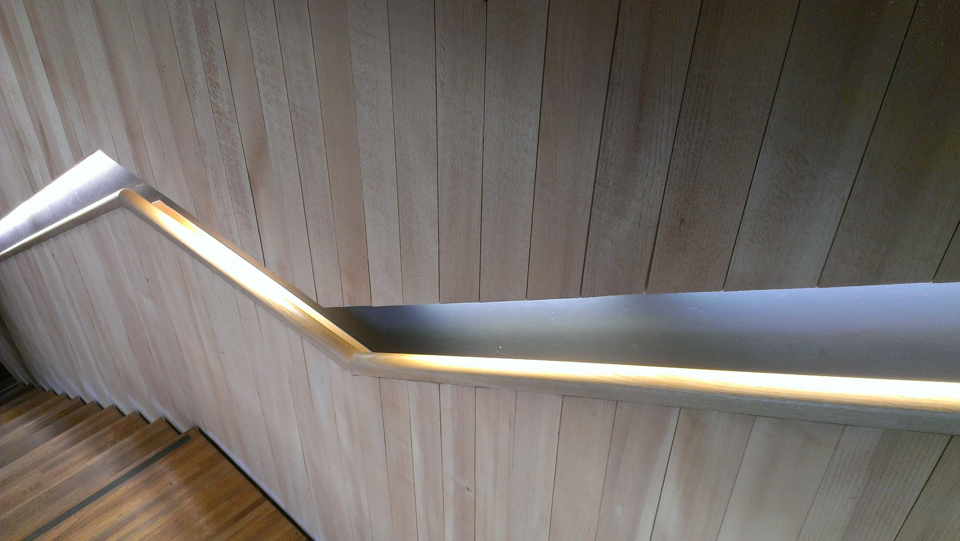
What amount of carbon dioxide is absorbed and what amount of oxygen released by one cubic meter of wood in its growing period?
A: It absorbs a ton of carbon dioxide and releases 0,7 tons of oxygen
2) What is the most vital formula:
A: 6H₂O + 6CO₂ + solar energy → C₆H₁₂O₆ +n 6O₂
3) Which of these five countries: Austria, Finland, Greece, Latvia or Spain is the most wooden (from forest covering point of view)?
A: Finland
4) Name the most well-known Forest certification schemes
A: Forest Stewardship Council of FSC and Programme for the Endorsement of Forest Certification of PEFC
5) Which wood species are mostly used for structures?
A: Spruce, pine, larch, oak birch (as plywood material)
6) Name some advantages of structural steel?
A: compression and tensile strength; fire resistance; durability; in structure like footings, dams, piers etc. reinforced concrete is the most economical construction material
7) Name some advantages of reinforced concrete?
A: steel has a high strength/weight ratio; ductility; speed of erection; ease of repair; repetitive use; expanding existing structures
8) Name some advantages of structural wood?
A: tensile strength in fiber direction; electrical and heat resistance; sound absorption; locally sourced; environmentally friendly
9) How does Cross laminated timber (CLT) can be made without glue?
A: by nailing, doweling or swelling force of wood
10) What are the advantages of wood-based panels (WBP)?
A: very large and variable sizes; form stability, no deformation due to changes of relative humidity
11) Where the plywood can be used?
A: roof substructures; subfloor material; stiffening boarding for wall and load-bearing structures; interior lining; shuttering
12) What types of particle boards are known?
A: particle board, oriented strand board, Cement bonded particle board, fibrolite
13) Name two main categories wood fiber board can be divided into:
A: porous (used for thermal insulation); hard (MDF, HDF – for floors etc.)
14) Name the content of wood plastic composites
A: wood fiber/wood flour and thermoplastics such as polyethylene (PE), polypropylene (PP), polyvinylchloride (PVC) or others.
QUESTIONS AND ANSWERS
14
LESSON 3: Availability and environmental friendliness of wood as building material

Slide 15
EN 300:2006 Oriented Strand Boards (OSB) – Definitions, classification and specifications.
EN 312:2010 Particleboards. Specifications.
EN 316:2009 Wood fibre boards. Definition, classification and symbols.
EN 15804:2012+A1:2013 Sustainability of construction works. Environmental product declarations. Core rules for the product category of construction products.
EN 15978:2011 Sustainability of construction works. Assessment of environmental performance of buildings. Calculation method.
Gong M. Lumber-Based Mass Timber Products in Construction. Timber Buildings and Sustainability. DOI: 10.5772/intechopen.85808
ISO 14025:2006 Environmental labels and declarations — Type III environmental declarations — Principles and procedures.
ISO 14040:2006 Environmental management — Life cycle assessment — Principles and framework.
ISO 14044:2006 Environmental management — Life cycle assessment — Requirements and guidelines.
Kruse K., Venschott D. Eigenschaften und Einsatzpotentiale neuer Holzwerkstoffe im bauwessen, Institut für Holzphysik und mechanische Technologie des Holzes, 2001
Wood Handbook, Wood as an Engineering Material. Forest Products Laboratory. General Technical Report FPL-GTR-190. Forest Products Laboratory, USA, 2010., 508 p.
References
JOURNALS AND PUBLICATIONS
15
LESSON 3: Availability and environmental friendliness of wood as building material

